Slide 1
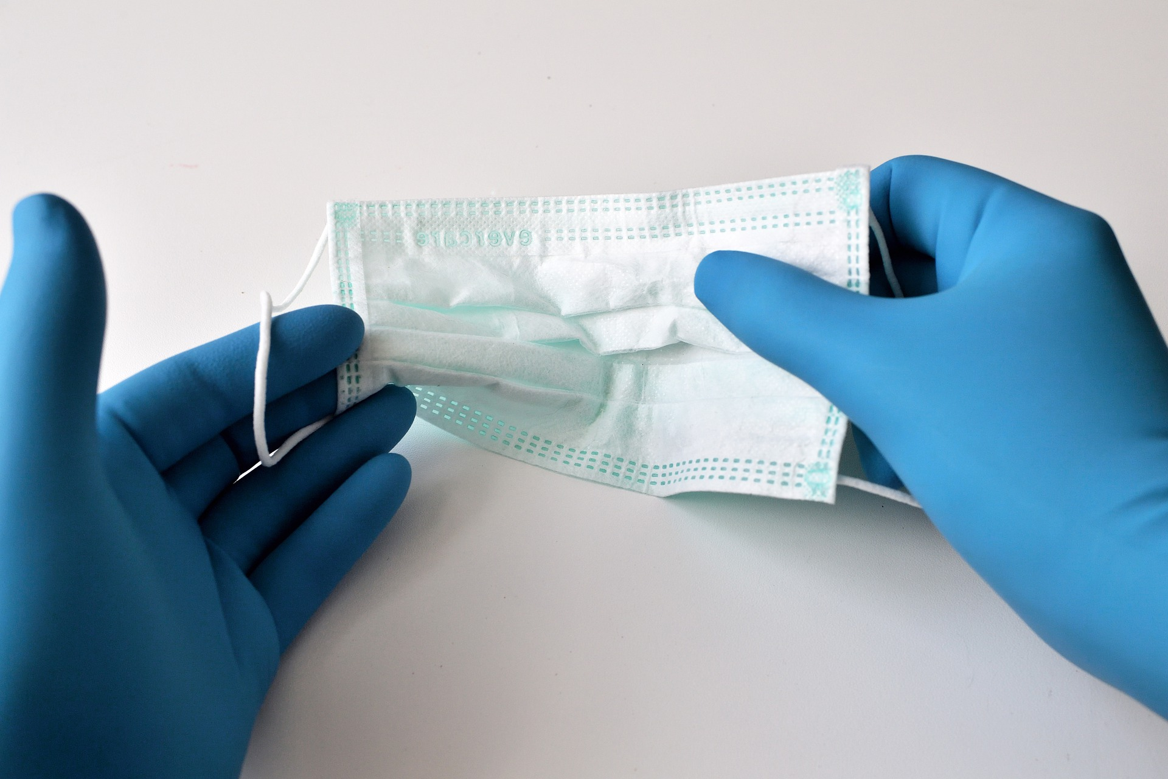
Facility Name
Project Name
Notes:
Right click -> Format Background -> Replace it with your picture ☺

Slide 2
Define the Problem
Background: Why did you choose this project? Why was it important to work on?
Briefly describe the problem you aim to improve. Describe why it matters to your patients, staff, or others.

Slide 3
Baseline Data
Baseline: What is your baseline data?
Provide your baseline data or current performance.

Slide 4
AIM Statement
Project Aim: What is your goal and how will it be measured?
State your improvement goal using SMART criteria: Specific, Measurable, Achievable, Relevant, Time-bound. Include who will do the work, what will improve, by when, and by how much.

Slide 5
Anticipated/Actual Outcomes
Outcomes: How will you know a change is an improvement?
Provide your outcome and process measures. Include balancing measures, if identified. Provide input on how often you collected the data and how. Include any data to date.

Slide 6
PDSA: Plan/Do
What did you do to make a change?
Provide an overview of your tests of change. What were you trying to test? Who was involved? What was the duration and scope? What will be done? How did you measure? What did you expect to happen? How were team members and patients engaged?

Slide 7
PDSA: Study
Explain the changes seen based on the data above or experiences; knowing some benefits may not be measurable in numbers.
If you have done small tests of change, outline your results, data can be included in the table below if you choose. If you are still in the “do” phase, explain how you will study the impact. Summarize your insights. Include data if available.
 | BASELINE VALUE | REMEASURE VALUE | Did you improve?
Measure 1
Measure 2
Measure 3
** This slide can be modified if you have not yet completed any tests of change. You can use as an additional Plan/Do slide, etc.

Slide 8
PDSA: Act
What are you going to do next?
Adopt, Adapt, or Abandon?
Changes to be made?
Lessons Learned?
Next steps or future goals?
Conclusion
** This slide can be deleted if you have not reached this part of your PDSA cycle.

Slide 9
Project Acknowledgements
Project Team Members Name & Titles

