Slide 1
Cultivating Champions of Quality
Session 1: Getting to Know You
March 6, 2024
Notes:
Right click -> Format Background -> Replace it with your picture ☺

Slide 2
Champions for Quality Improvement
The Champions of Quality Improvement Cohort (QI Champions) is an opportunity funded by MT Flex and HQIC programs.
There is a wide spectrum of healthcare quality expertise and interest and with this opportunity we hope to provide support to healthcare staff that are highly skilled and knowledgeable in their role but may be less familiar with the workings of quality improvement. This opportunity includes education and discussion to help in developing hospital-wide competency in QI methods.
Image Source: https://khn.org/news/article/montana-hospital-pricing-public-employees/

Slide 3
Participants
Participant Organizations:
Barrett Hospital & Healthcare Logan Health - Conrad
Billings Clinic Broadwater Logan Health - Whitefish
Bozeman Health Madison Valley Manor
Central Montana Medical Center Madison Valley Medical Center
Community Hospital of Anaconda Memorial Hospital of Carbon County
Dahl Memorial Hospital Association Montana Mental Health Nursing Care Center
Garfield County Health Center Pioneer Medical Center
Great Falls Hospital & Clinic Shodair Children’s Hospital
Livingston HealthCare Sidney Health Center
Logan Health St. Peter’s Health
Logan Health – Cut Bank Stillwater Billings Clinic
Logan Health - Shelby The Ivy at Deer Lodge
Tobacco Roots Mountain Care Center
Wheatland Memorial Healthcare

Slide 4
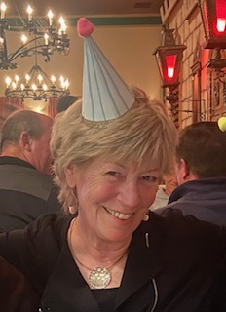
Barb DeBaun
MSN, RN, CIC
Improvement Advisor
Cynosure Health
I have worked in healthcare for 48 years.
I have worked in quality for 45 years.

Slide 5
Barb DeBaun
My greatest professional strength is influencing others to try something new
My greatest professional weakness is not asking for help
I could use some support in getting recharged

Slide 6
Barb DeBaun
What I love most about my work is all of YOU!
My biggest quality goal for ‘my’ hospitals is building capacity for healthcare quality

Slide 7
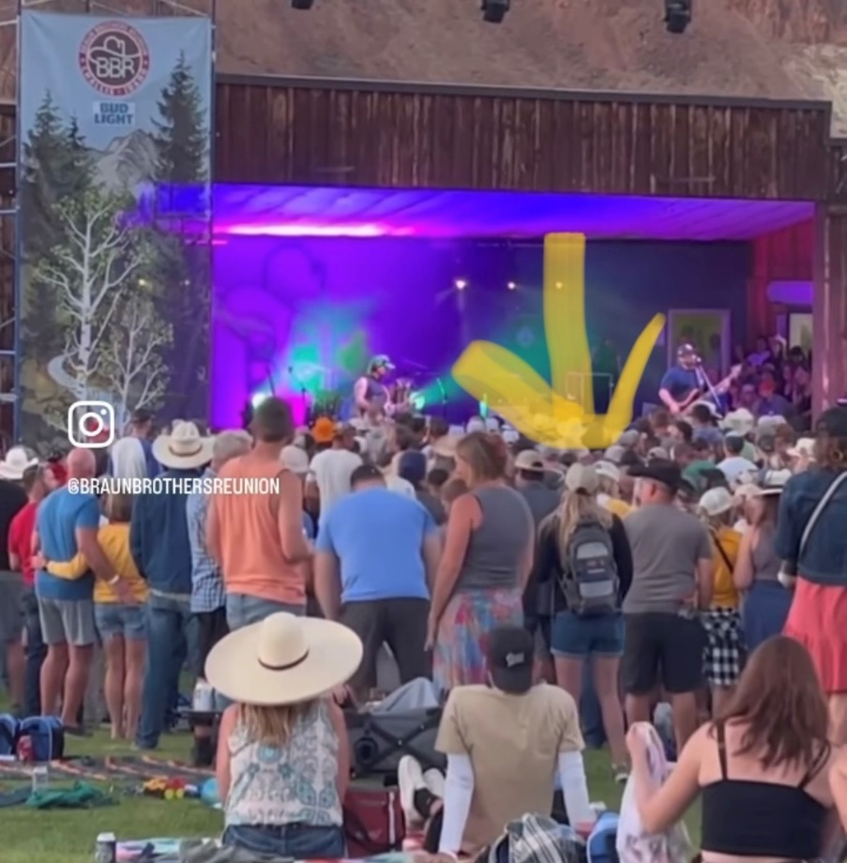
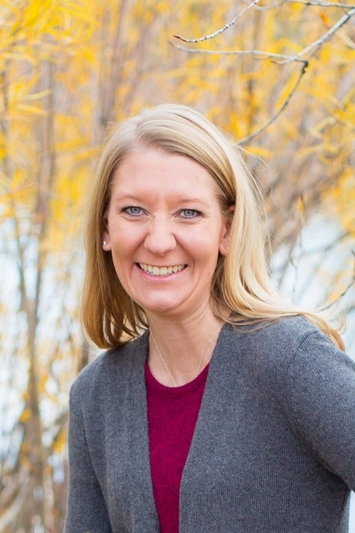
Casey Driscoll
CPHQ
Director of Quality Programs
Montana Hospital Association
I have worked in healthcare for over 11 years.
I have worked in quality for most of them. I took a 3-year venture into Emergency Preparedness but never really shook my quality roots.

Slide 8
Casey Driscoll
My greatest professional strength is that I’m not afraid to ask why something is the way it is.
My greatest professional weakness is trying to tackle all the things at once.
I could use some support in feeling confident in my skills and knowledge.

Slide 9
Casey Driscoll
What I love most about my work is getting on the road and visiting facilities.
My biggest quality goal for ‘my’ hospital is building the confidence to showcase the good work that is being done.

Slide 10
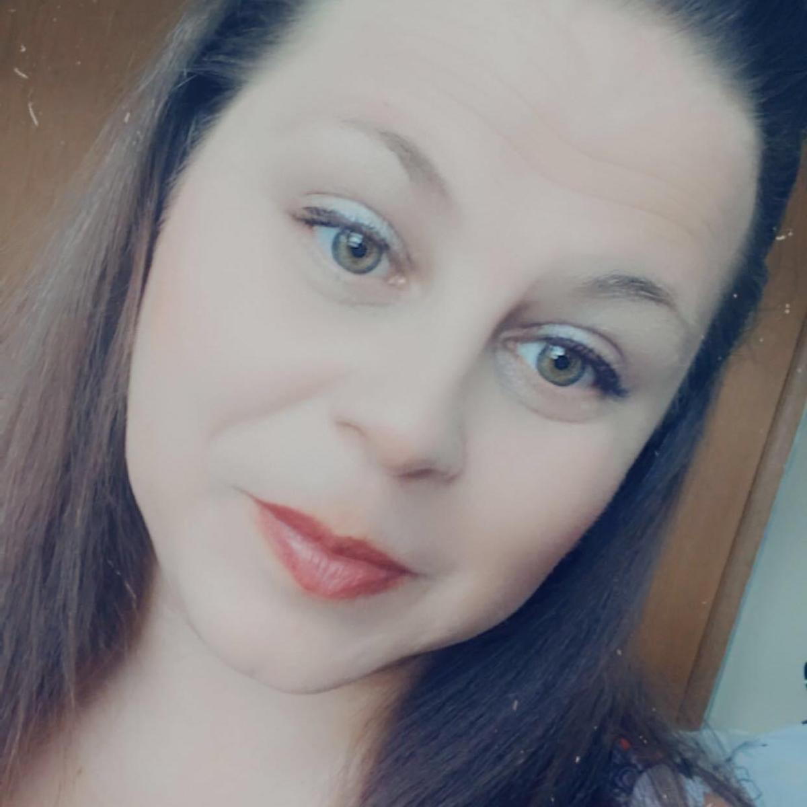
Heather Etheridge
MPH, LPN
Quality Coordinator/IC and EH Nurse
Wheatland Memorial Healthcare
I have worked in healthcare for 23 years. A nurse for almost 17.
I have worked in quality for 4 months.

Slide 11
Heather Etheridge
My greatest professional strength is drive and compassion.
My greatest professional weakness is wanting to be perfect.
I could use some support in learning regulatory requirements.

Slide 12
Heather Etheridge
What I love most about my work is I am a data-driven person, hence why I am decent with infection control. But I also love teaching people and helping people breakdown issues and help fix processes.
My biggest quality goal for my hospital is prior to me coming there was a lack of SMART goals. So this year, I have changed our Quality plan to use PDSA formatting which includes SMART Goals. One area though that I am helping with is a falls prevention program.

Slide 13
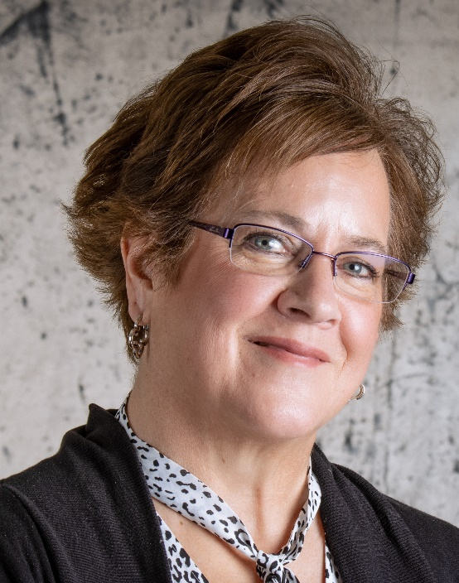
Sheila Sherman
RN, DNP, APRN, CNS, CPPS
CNO
Dahl Memorial Healthcare Association Inc.,
I have worked in healthcare for 32 short years.
I have worked in quality for 10 years.

Slide 14
Sheila Sherman
My greatest professional strength is mentoring and coaching.
My greatest professional weakness is not recognizing when I have exceeded and or I am approaching my capacity.
I could use some support in CAH regulatory compliance related to quality. I have spent my career in large acute care hospitals (PPS) and CAH is a different platform.

Slide 15
Sheila Sherman
What I love most about my work is mentoring nurses and nurses pursuing leadership.
My biggest quality goal for my hospital is to create systems and automation. We are just a bit behind the times.

Slide 16
Jen Larson
BA, BSN, RN, CIC
Infection Prevention Coordinator
Logan Health Kalispell
I have worked in healthcare for 13 years.
I have worked in quality for almost 10 years.

Slide 17
Jen Larson
My greatest professional strength is team collaboration.
My greatest professional weakness is overthink and struggle with conflict.
I could use some support in implementation of new, or improved processes.

Slide 18
Jen Larson
What I love most about my work is getting to work with every department of the healthcare setting.
My biggest quality goal for my hospital is sustained improvement for staff and patients in safety.

Slide 19
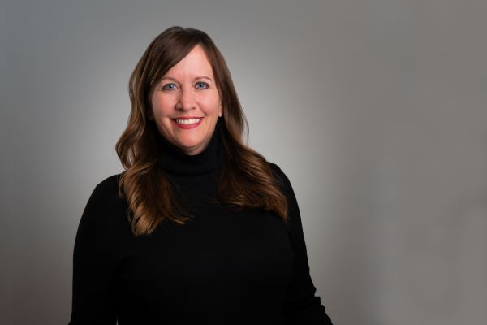
Barbara Neidich
BSN,RN
System Manager of Accreditation, Quality Management and Infection Prevention
Bozeman Health
I have worked in healthcare for 15 years.
I have worked in quality for 8 months.

Slide 20
Barbara Neidich
My greatest professional strength is collaboration and problem solving.
My greatest professional weakness is experience in quality and lack of confidence.
I could use some support in QI project understanding and how to communicate with leaders to disseminate to teams.

Slide 21
Barbara Neidich
What I love most about my work is that with my background of being a front line staff nurse and also a house supervisor I feel I can make a difference and see the positive changes by the quality department .
My biggest quality goal for my hospital is patient safety/serious safety events target < 3.

Slide 22
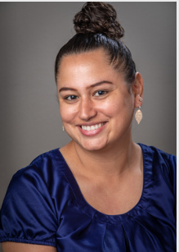
Rachel Naples
Quality Improvement
Logan Health Whitefish
I have worked in healthcare for 4.5 years.
I have worked in quality, risk, and performance improvement for almost 2 years.

Slide 23
Rachel Naples
My greatest professional strength is communication.
My greatest professional weakness is saying “NO”.
I could use some support in boundaries and priorities.

Slide 24
Rachel Naples
What I love most about my work is being a patient advocate and process improvement support person for our team. I have many things I love about my job so choosing one is difficult. Here are the top 3
People bring their authentic self to work
Planetree Culture, Just Culture
Patient Safety
My biggest quality goal for my hospital is to continue to foster a Just Culture and follow our Planetree philosophy.

Slide 25
Julie Wyant
MA in Human Services in Counseling: Health & Wellness. Currently pursuing CMHC degree to become an LCPC.
Quality Specialist
St. Peter’s Health
I have worked in healthcare for six years.
I have worked in quality for two months.

Slide 26
Julie Wyant
My greatest professional strength is streamlining processes.
My greatest professional weakness is healthy work time boundaries.
I could use some support in effectively delivering QI data to others within the organization to implement change.

Slide 27
Julie Wyant
What I love most about my work is being a part of saving patients lives through quality improvement processes.
My biggest quality goal for my hospital is to be a resource for all staff and patients.

Slide 28
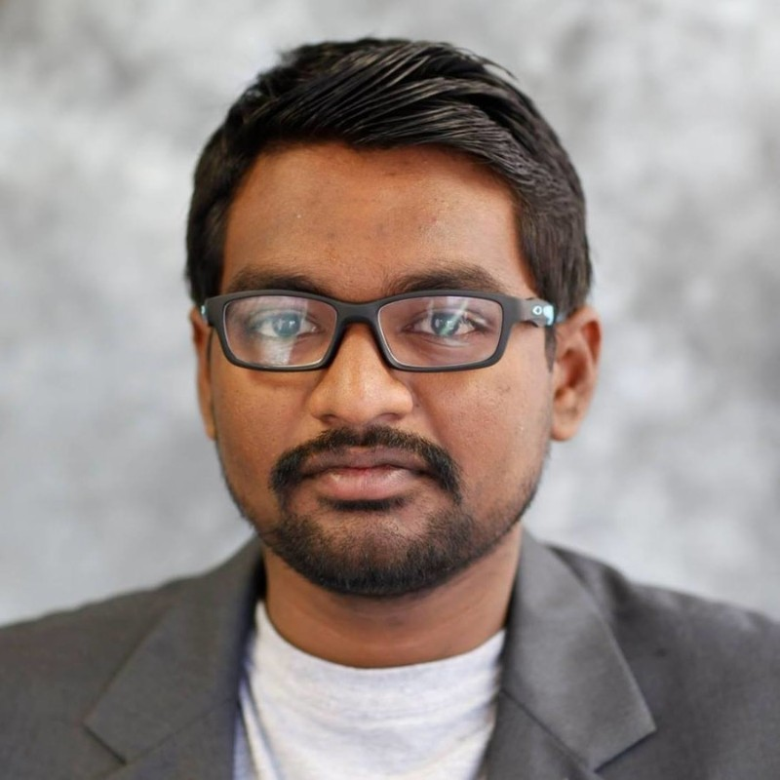
Hemanth Modadugu
MBA, MHA, BDS, HACP
Quality Specialist
St. Peter’s Health
I have worked in healthcare for 10 years (7 in the US)
I have worked in quality for 6 years

Slide 29
Hemanth Modadugu
My greatest professional strength is being able to collaborate with anyone across the board to achieve the goals.
My greatest professional weakness is working with certain personalities.
I could use some support in building programs.

Slide 30
Hemanth Modadugu
What I love most about my work is dynamic and challenging nature of the quality department and the work we do.
My biggest quality goal for my hospital is rebuilding and re-establishing a comprehensive QAPI program.

Slide 31
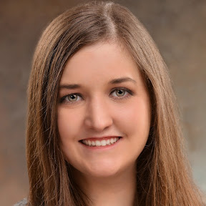
Katie Wahl, RN MSN
I am the Quality, Risk and Accreditation RN Specialist at Shodair Childrens Hospital in Helena, MT
I have been at Shodair and working in healthcare for the last 9.5 years. Holding Floor Nurse, House Supervisor and Unit Supervisor roles.
I have worked in quality since the very end of November 2022.

Slide 32
Katie Wahl
My greatest professional strength is bringing humor to the situation but also working well with a team to tackle a common goal.
My greatest professional weakness is brining humor and distracting myself and others.
I could use some support in getting the buy in from those that have the “no change” mindset.

Slide 33
Katie Wahl
What I love most about my work is knowing that no matter where my role lies within an organization, myself and those I work with are better the lives of kiddos across Montana.
My biggest quality goal for my hospital is to support supervisors and directors to understand the need to collect data, how to analyze that data, and how to use it to make positive changes.

Slide 34
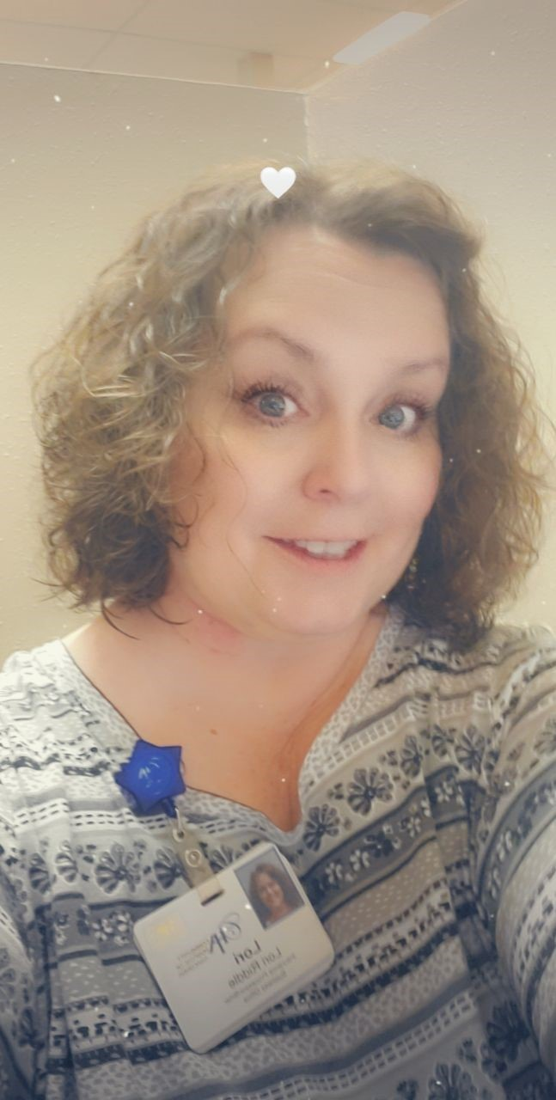
Lori Riddle
CPC
Clinic Chart Auditor / Coder
Community Hospital of Anaconda
I have worked in healthcare for 14 years.
I have worked in quality for 6 years.
Insert Photo

Slide 35
Lori Riddle
My greatest professional strength is organization.
My greatest professional weakness is pronouncing some of the medical terms.
I could use some support in not sure ?

Slide 36
Lori Riddle
What I love most about my work is figuring out solutions to problem encounters or find ways to help increase our revenue.
My biggest quality goal for my hospital is ? Not sure? Maybe I will know after these trainings ☺

Slide 37
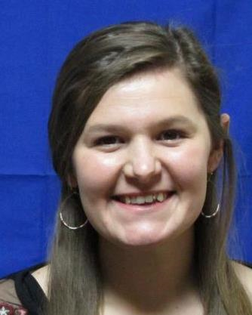
Esther Bradley
BS-Medical Office Admin
Quality Analyst
Central Montana Medical Center
I have worked in healthcare for 5 years.
I have worked in quality for 3.5 years.
Insert Photo

Slide 38
Esther Bradley
My greatest professional strength is getting projects done in a timely manner.
My greatest professional weakness is taking on too many projects.
I could use some support in learning new data requirements.

Slide 39
Esther Bradley
What I love most about my work is seeing my work make a difference.
My biggest quality goal for my hospital is to see better participation from other departments.

Slide 40
Jody Lizotte
RN
MDS, DON
Tobacco Root Mountains Care Center
I have worked in healthcare for 26 years
I have worked in quality for 4 years total, off and on (officially) but every work day really.

Slide 41
Jody Lizotte
My greatest professional strength is very detail oriented.
My greatest professional weakness is drawing labs.
I could use some support in reporting needs in LTC.

Slide 42
Jody Lizotte
What I love most about my work is the residents and staff.
My biggest quality goal for my hospital is continue quality care for the residents.

Slide 43
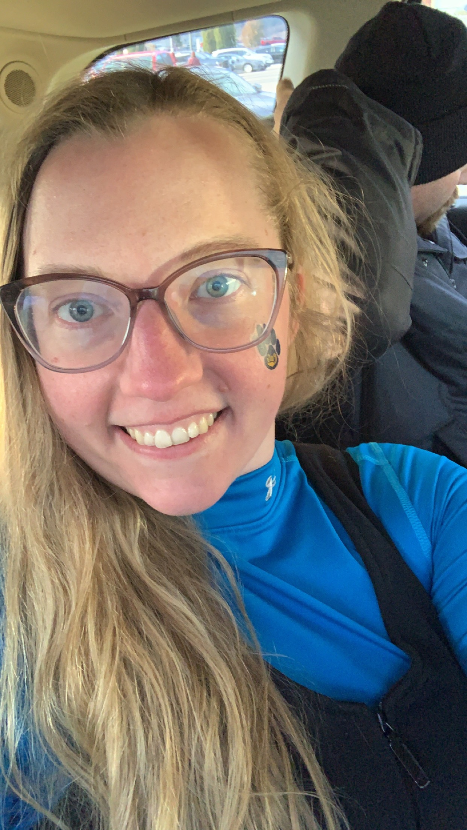
Mackenzie Sly
BSN, CDONA, RN
Director of Nursing, Care Center
Logan Health Conrad
I have worked in healthcare for 6+ years
I have worked in quality for 1+ years.
Insert Photo

Slide 44
Mackenzie Sly
My greatest professional strength is timeliness on tasks.
My greatest professional weakness is spending too much time in the office, not connecting with my staff on the floor.
I could use some support in meeting quality metrics.

Slide 45
Mackenzie Sly
What I love most about my work is making a positive difference in resident and their family's lives.
My biggest quality goal for my hospital is reducing fall w/ major injury.

Slide 46
Stacey McManamen
BSN, RN
Quality RN
Pioneer Medical Center, Big Timber, MT
I have worked in healthcare for almost 20 years.
I have worked in quality for 13 months.

Slide 47
Stacey McManamen
My greatest professional strength is my curiosity and that I enjoy learning new things.
My greatest professional weakness is speaking to a large group.
I could use some support in learning how to engage others in QI and how to facilitate QI projects.

Slide 48
Stacey McManamen
What I love most about my work is finding ways to improve processes that will improve safety and satisfaction for both patients and staff.
My biggest quality goal for my hospital is to provide high quality care for our patients and residents.

Slide 49
Ashton Sullivan
BSN, RN
Infection Control RN
Stillwater Billings Clinic
I have worked in healthcare for 15 years.
I have worked in quality for 2 years.

Slide 50
Ashton Sullivan
My greatest professional strength is the ability to be detail oriented.
My greatest professional weakness is real time “coaching.”
I could use some support in transferring manual surveillance methods into electronic.

Slide 51
Ashton Sullivan
What I love most about my work is using science and data to learn and make changes, I also love the flexibility I have with raising my kids.
My biggest quality goal for my hospital is getting enough data that the numbers will start to be meaningful. Example we can compare how we are doing against other years.

Slide 52
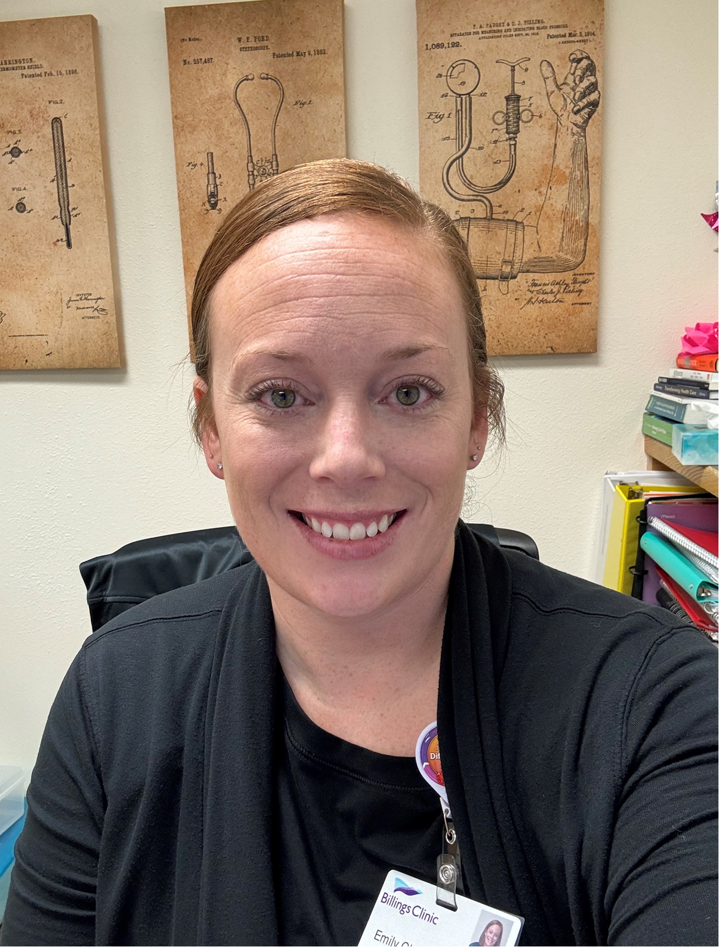
Emily Clark
RN
Quality and Infection Control
Billings Clinic Broadwater
I have worked in healthcare for 12 years.
I have worked in quality for just shy of 2 years
Insert Photo

Slide 53
Emily Clark
My greatest professional strength is collaboration.
My greatest professional weakness is I am a “yes” person and take on a lot at once.
I could use some support in all things Quality. I am trying to be a sponge as I am learning this role ☺

Slide 54
Emily Clark
What I love most about my work is problem solving.
My biggest quality goal for my hospital is continued work on our Dashboard and survey readiness

Slide 55
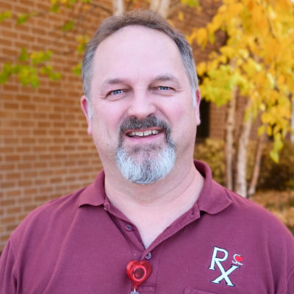
Greg Weller, RPH, ASC, BSC
Pharmacy Manager
St. Luke Community Healthcare
20+ years of healthcare experience
I could use some support in almost everything! QA/QI/QC is not my strong suit. My weakness is I like to solve problems as they arise and not study them for extended periods.
What I love most about my work is being able to help people navigate the confusing, and often complex, landscape of healthcare.

Slide 56
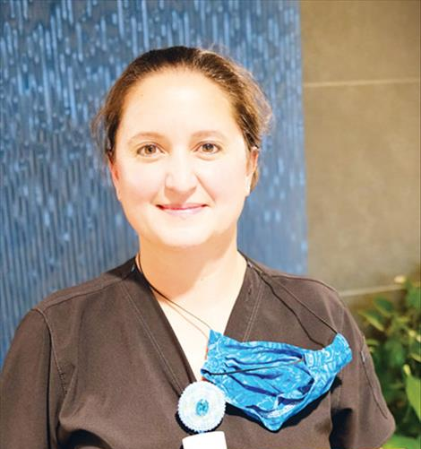
Stephanie Reffner, BSN, RN
ER Manager
St. Luke Community Healthcare
18 years of healthcare experience
I could use some support in loop closure.
What I love most about my work are the people. The patients are the purpose of our work.

Slide 57
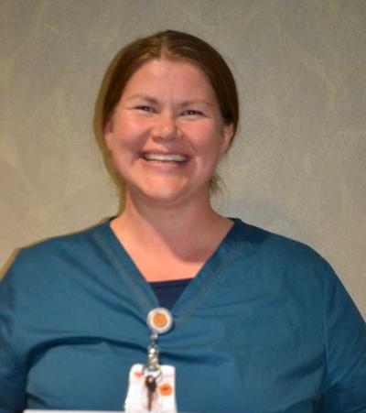
Casey Houk, BSN, RN, OB RNC, CLC
OB Manager
St. Luke Community Healthcare
24 years of healthcare experience
I could use some support in learning how to navigate quality improvement and what the terms mean.
What I love most about my work are working with new families. Birth is such an inspiring time to behold. I love being there to witness the golden hour when bewildered exhausted people become parents and experience the most profound love and devotion they will ever feel in their lives.

Slide 58
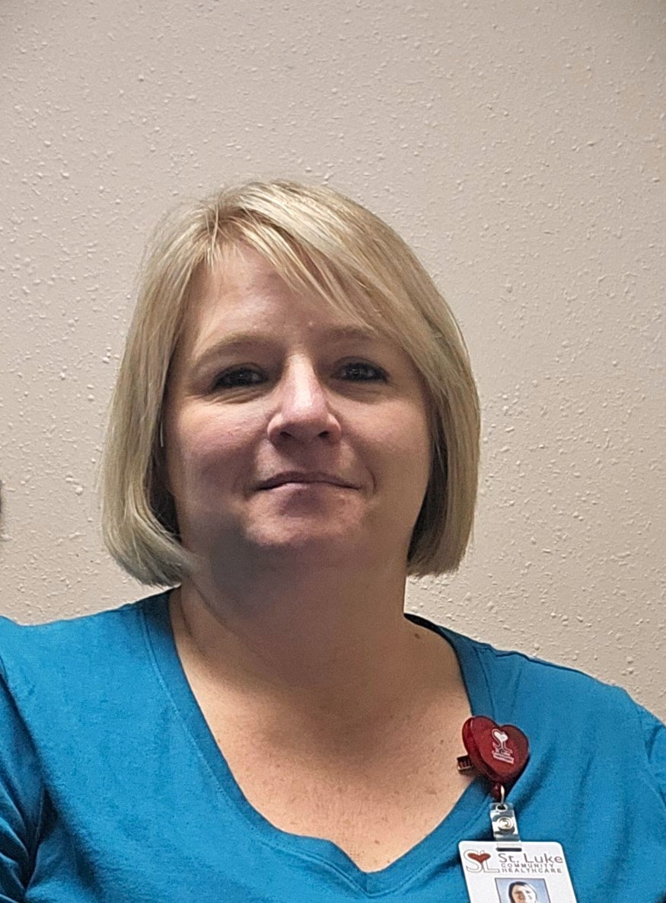
Shonna Elverud
Controller
St. Luke Community Healthcare
25 years of healthcare experience
What I love most about my work is working with great co-workers that really care about their jobs and facing the challenges of the ever-changing healthcare system!

Slide 59
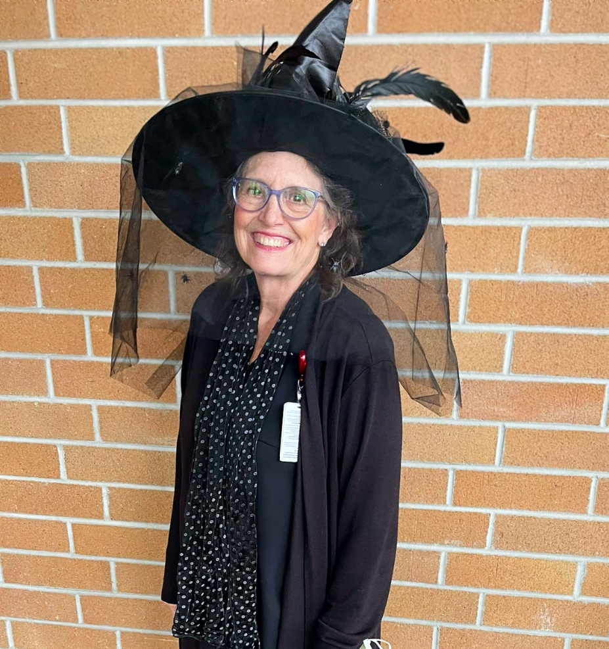
Deb Thompson
Environmental Services Manager
St. Luke Community Healthcare
25+ years of healthcare experience
What I love most about my work is the people I work with.

Slide 60
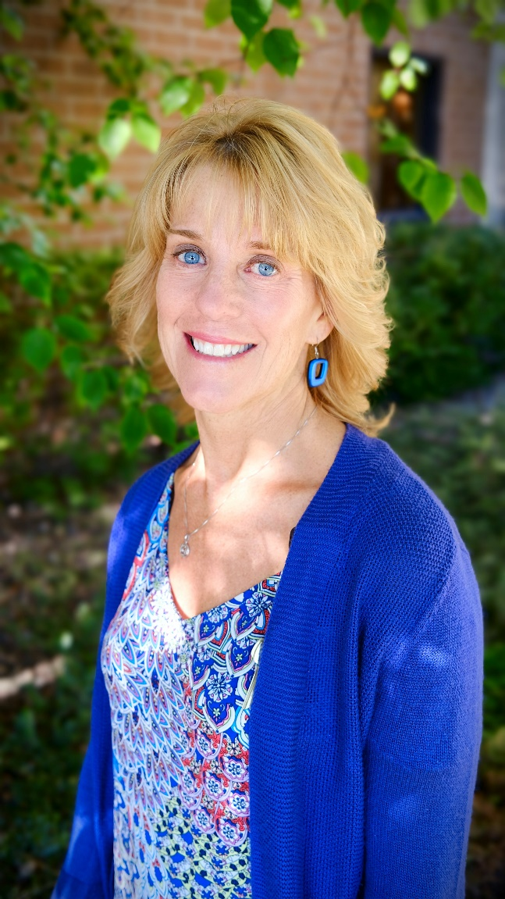
Diane Grogan, RDN
Registered Dietitian Nutritionist and Dietary Manager
St. Luke Community Healthcare
30 years of healthcare experience
I could use some support in clinic aspects, such as ways to gather/report data in a timely and efficient manner and food service management aspects.
What I love most about my work is teaching others about good nutrition to help them be and feel their best.

Slide 61
Bruce Genzel, RN
OR Manager
St. Luke Community Healthcare
9 years of healthcare experience
I could use some support in learning how to complete a root cause analysis.
What I love most about my work is my team.

Slide 62
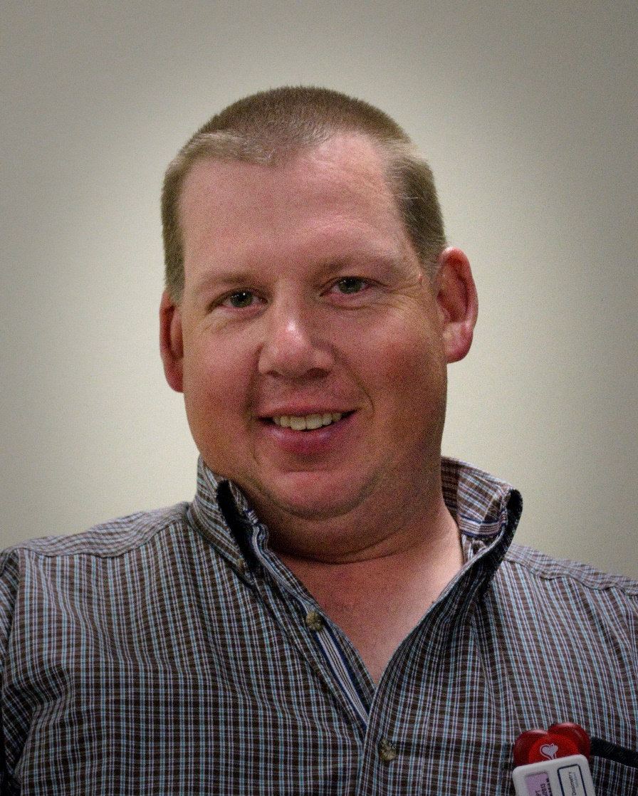
Craig Rider, ARRT (R)
Imaging Manager
St. Luke Community Healthcare
10 years of healthcare experience
I could use some support with data collection.
What I love most about my work is the diversity between the modalities and helping the patients.

Slide 63
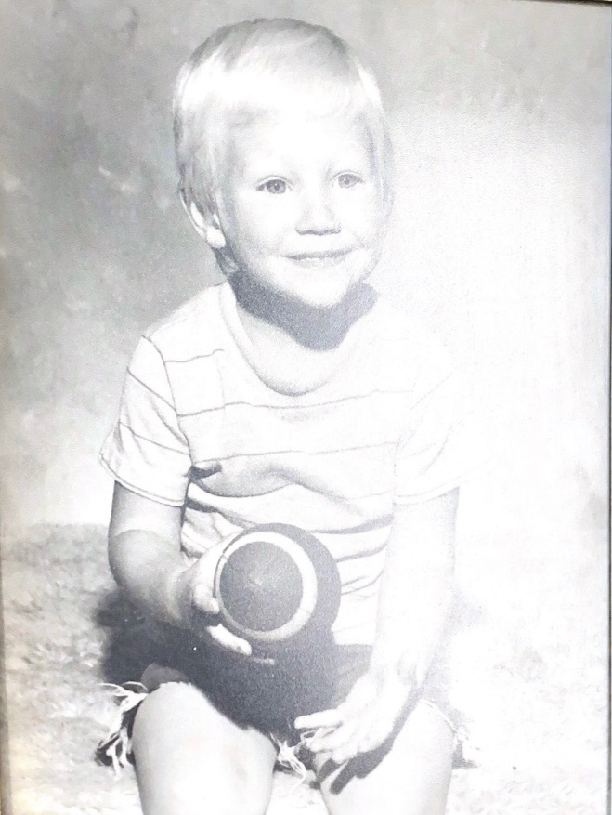
Brandon Hungerford, RCP
Echocardiography Tech
Cardiopulmonary and DME Services Manager
St. Luke Community Healthcare
30 years of healthcare experience
I could use some support in discovering ways to receive properly filled out orders for DME braces along with prior-authorization from insurances.
What I love most about my work is the comradery of building relationships with people; and I love being an asset to someone’s better wellbeing and health.

Slide 64
Schedule
March 6 Session 1: Get to Know You
March 20 Session 2: Facilitation & Project Management Skills
April 24 Session 3: Engaging others in QI
May 1 Session 4: Performing FMEA/RCA/etc & Use of Discovery Tool
May 22 Session 5: Data Collection, Analysis & Display
June 12 Session 6: Just Culture & Communication

Slide 65
Contact
Casey Driscoll, CPHQ | Barb DeBaun, MSN, RN, CIC
Montana Hospital Association | Cynosure Health
Director of Quality Programs | Improvement Advisor
Casey.Driscoll@mtha.org | barbdebaun@me.com

