Slide 1
QAPI
Quality Assessment & Performance improvement

Slide 2
What is QAPI?
Quality Assessment and Performance Improvement (QAPI) is a comprehensive data driven and proactive approach to quality improvement and ensuring high quality care.
All members at all levels of an organization are involved in continuously identifying opportunities for improvement. This includes front line staff and leadership of all departments and service lines, governing body, and patients.
The QAPI approach:
  Identifies opportunities for improvement
  addresses gaps in systems or processes
  develops and implements an improvement or corrective plan
  continuously monitors effectiveness of interventions.

Slide 3
What is QAPI
QA
PI
QAPI
 | Quality Assessment | Performance Improvement
Motivation | Measuring compliance with standards | Continuously improving processes to meet standards
Means | Inspection | Prevention
Attitude | Reactive - Required | Proactive - Chosen
Focus | Outlier or Individuals | Processes or systems
Responsibility | Few | All
Notes:
QA: process of meeting quality standards and assuring care reaches an acceptable level. Hospitals typically set QA thresholds to comply with regulations. They may also create standards that go beyond regulations. QA is a reactive and retrospective effort to examine why a facility failed to meet certain standards. QA activities do improve quality, but improvement efforts frequently end once the standard is met. *Gap Analysis *Root Cause Analysis– Discovery Tools*
PI is a proactive and continuous study of processes. The intent is to prevent or decrease the likelihood of problems by identifying areas of opportunity and testing new approaches to fix underlying causes of persistent/systemic problems. PI can make good quality even better. *Driver Diagrams – Interviews – Observations – STOC*

Slide 4
CAH Regulations
§ 485.641 Condition of Participation: Quality assessment and performance improvement program.
The CAH must develop, implement, and maintain an effective, ongoing, CAH-wide, data-driven quality assessment and performance improvement (QAPI) program. The CAH must maintain and demonstrate evidence of the effectiveness of its QAPI program.
This is not updated yet in the State Operations Manual. Refer to the Federal Register posting at this link for guidance: https://www.ecfr.gov/current/title-42/chapter-IV/subchapter-G/part-485/subpart-F/section-485.641

Slide 5
Design & Scope
QAPI Program Design and Scope
(1) Be appropriate for the complexity of the CAH's organization and services provided.
(2) Be ongoing and comprehensive.
(3) Involve all departments of the CAH and services (including those services furnished under contract or arrangement).
(4) Use objective measures to evaluate its organizational processes, functions and services.
(5) Address outcome indicators related to improved health outcomes and the prevention and reduction of medical errors, adverse events, CAH-acquired conditions, and transitions of care, including readmissions.
Notes:
What triggers an action
QAPI Plan

Slide 6
Governance & Leadership
Standard: Governance and leadership.
The CAH's governing body or responsible individual is ultimately responsible for the CAH's QAPI program and is responsible and accountable for ensuring that the QAPI program meets the requirements of paragraph (b) of this section.
Notes:
Board Report Template
What does this mean?
The governing body assures adequate resources exist to conduct QAPI efforts.
The Governing Body should foster a culture where QAPI is a priority by ensuring that policies are developed to sustain QAPI despite changes in personnel and turnover. Their responsibilities include, setting expectations around safety, quality, rights, choice, and respect by balancing safety with resident-centered rights and choice.
The governing body ensures staff accountability, while creating an atmosphere where staff is comfortable identifying and reporting quality problems as well as opportunities for improvement.

Slide 7
Program activities
Standard: Program activities. For each of the areas listed in paragraph (b) (Design & Scope)of this section, the CAH must:
(1) Focus on measures related to improved health outcomes that are shown to be predictive of desired patient outcomes.
(2) Use the measures to analyze and track its performance.
(3) Set priorities for performance improvement, considering either high-volume, high-risk services, or problem-prone areas.
Notes:
Setting benchmarks and goals
SMART Goals
GO TO GEMBA

Slide 8
Program data collection and analysis
Standard: Program data collection and analysis. The program must incorporate quality indicator data including patient care data, and other relevant data, in order to achieve the goals of the QAPI program.
  Input from staff, residents, families, and others as appropriate.
  Using benchmarks and performance indicators to monitor a wide range of care processes and outcomes.
  Review findings against benchmarks and/or targets the facility has established for performance.
Notes:
Data Crosswalk
Dashboard
Incremental change

Slide 9
Unified and integrated QAPI programS
Standard: Unified and integrated QAPI program for a CAH in a multi-facility system. If a CAH is part of a system consisting of multiple separately certified hospitals, CAHs, and/or REHs using a system governing body that is legally responsible for the conduct of two or more hospitals, CAHs, and/or REHs, the system governing body can elect to have a unified and integrated QAPI program for all of its member facilities after determining that such a decision is in accordance with all applicable state and local laws.
The system governing body is responsible and accountable for ensuring that each of its separately certified CAHs meets all of the requirements of this section. Each separately certified CAH subject to the system governing body must demonstrate that:
(1) The unified and integrated QAPI program is established in a manner that takes into account each member CAH's unique circumstances and any significant differences in patient populations and services offered in each CAH
(2) The unified and integrated QAPI program establishes and implements policies and procedures to ensure that the needs and concerns of each of its separately certified CAHs, regardless of practice or location, are given due consideration, and that the unified and integrated QAPI program has mechanisms in place to ensure that issues localized to particular CAHs are duly considered and addressed.

Slide 10
Measure Prioritization
Each department, service line, and contract service will identify or participate in development, monitoring and analysis of performance measures specific to their area, and/or will participate in a multi-disciplinary or organizational initiative that includes their area.
Benchmarks and/or targets for performance are determined for each measure for comparison and monitoring. Process, services, functions and outcomes will be measured
Notes:
The request we had for today was to talk about QAPI Dashboards and Engagement. A well designed dashboard and update process can increase staff engagement, buy in and ownership so we will start there.
Comment: If a department is involved in an organization goal or a multidisciplinary goaly, they do not need another department goal. In fact, multi-disciplinary goals are preferred!
Measure Inventory – PIN Website

Slide 11
CHOOSING measures
Quality and appropriateness diagnosis and treatment furnished by providers (C-0339)
Organizational priorities
Publicly reported data
Outcome indicators related to
  improved health outcomes
  reduction of medical errors
  reduction of adverse events
  hospital acquired conditions
  discharge planning/TOC/readmission
Medication management
  Medication Errors (C-1018)
  Adverse Drug Reactions (C-1018)
  Antibiotic Stewardship (485.640)
Utilization of blood and blood products (CLIA)
Management of information including medical records (485.635)
Infection Prevention
  Healthcare Acquired Infections (485.640)
  Infectious Disease (485.640)
New planned services or programs
New or revised evidence based care guidelines
Recommendations from medical staff and leaders
Medical errors (New CoPs)
Adverse events (New CoPs)
Restrains and seclusion - (New CoPs)
Patient satisfaction (New CoPs)

Slide 12
Notes:
CMS loves if measures come from current initiatives such as MBQIP, HQIC, OQR, IQR

Slide 13
Measure CROSSWALK
Identify measurable quality and safety indicators using:
  State Administrative Codes
  CMS Conditions of Participation
  The Joint Commission or DNV standards
  Corporate Quality and Safety Goals

Slide 14
Measure CROSSWALK
Use the QAPI Crosswalk to create measurable quality/safety indicators
  What sources of data do we have to support the metric?
  Does the numerator measure what we think it measures?
  Does the denominator represent the right population?
  Do we have a benchmark or target?
  Are the resulting data actionable?
  Create Indicator specifications

Slide 15
Crosswalk

Slide 16
MULTIDISCIPLINARY ENGAGEMENT
Notes:
This is a synergy grid. For each goal, the role of a department is noted.
NOTE: QUALITY IS SUPPORT!!!

Slide 17
QAPI DaSHBOARD
Data Owner (abstractor)
Process Owner (PI)
Target
Definition
Source
Frequency
Rational for Selection
Rational for Target
Notes:
A QAPI Dashboard has all QAPI measures in one place. Ideally this is on a shared drive that team members can update and see in real time.
We are going to look at some – I’d love conversation and if the document owner is here to share about it. Maybe we can find some other important items to include that will be helpful for improvement and engagement.

Slide 18
Building a program
Keep it
SIMPLE
Keep it
MEANINGFUL
Keep it
CURRENT

Slide 19
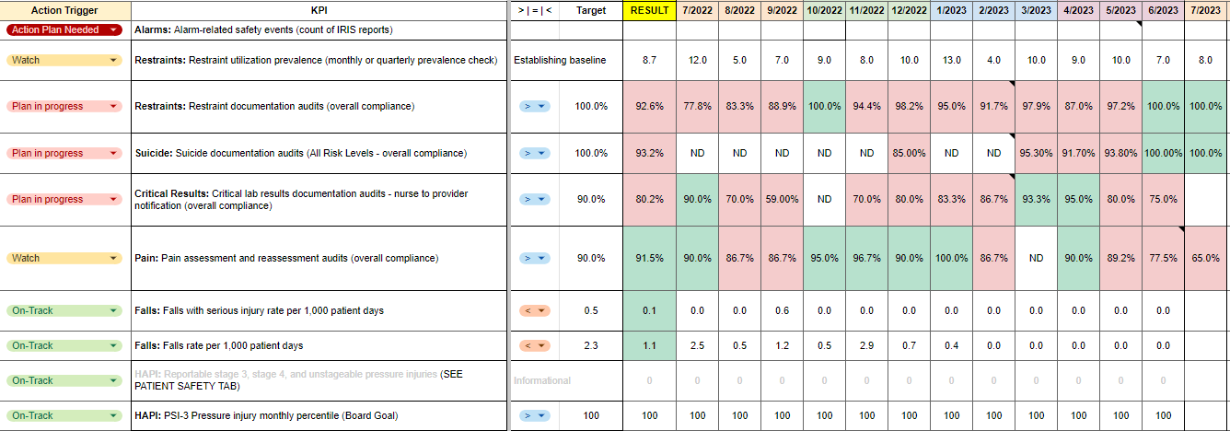
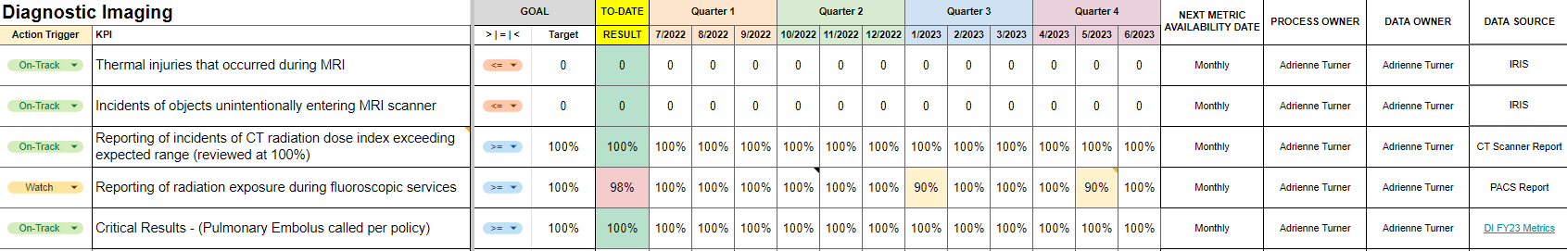
Credit: Virginia Mason (From MHCC QAPI Session by Jamie moran)
Notes:
This was a GOOGLE SHEET!

Slide 20
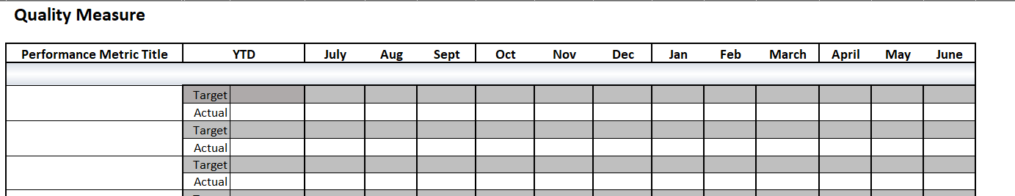
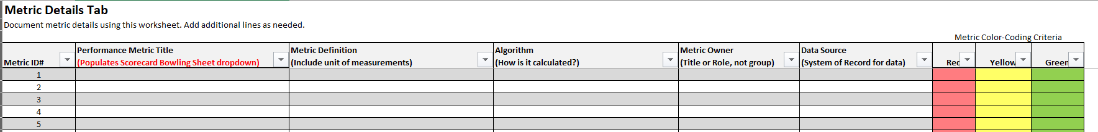
Notes:
Facility 1 (Mountainview Medical Center)

Slide 21
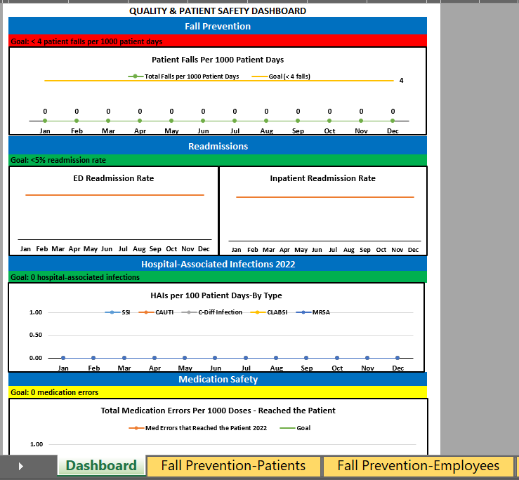
Notes:
Facility 2 CMMC - Hospital Wide
- Tabs on bottom

Slide 22
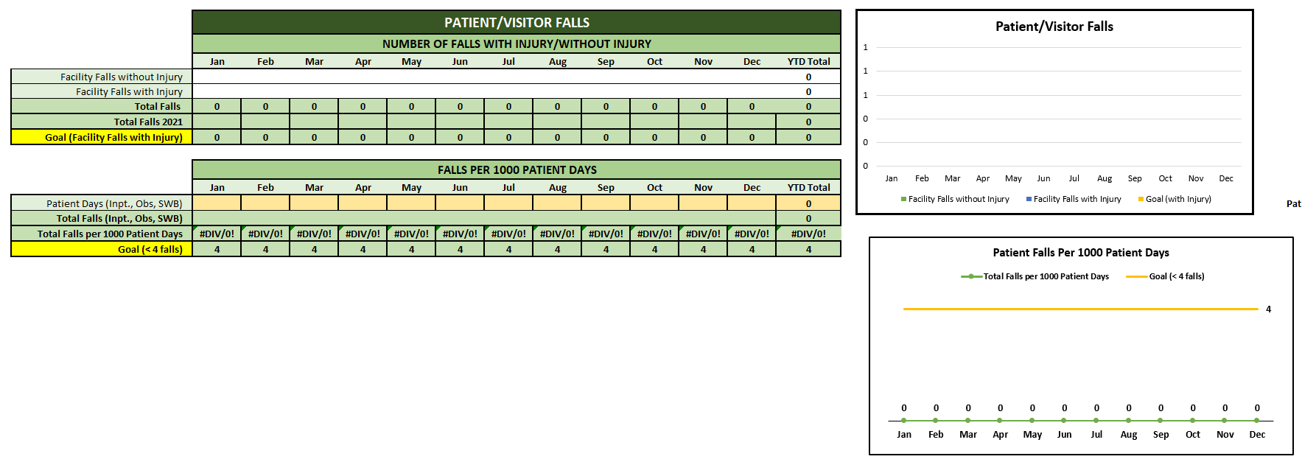
Notes:
Facility 2 (CMMC) Dept/line

Slide 23
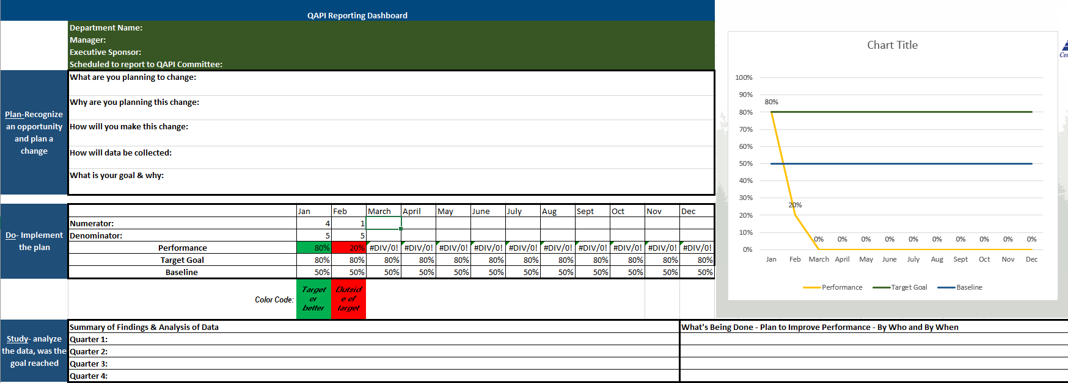
Notes:
Facility 2 (CMMC) Departmental Dashboard

Slide 24
Notes:
Facility 3 (CFVH)

Slide 25
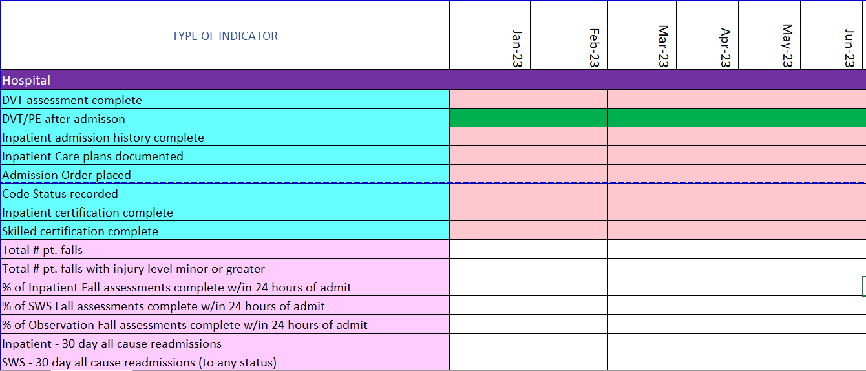
Notes:
Facility 4 (Daniels) Color coded for staff who are supposed to enter

Slide 26
Engagement

Slide 27

Why is QAPI Important?
Patient Safety & Satisfaction
Staff Safety & Satisfaction
Systematic and data driven
Notes:
*Brainstorm - Write on Sticky Pad
*Come back to sticky pad in “engagement section

Slide 28

Rules of engagement
Go to the GEMBA
Involve staff doing the work where the work takes place.
Are processes designed to make it easy to do the right thing?
Discuss solutions with staff
https://www.lean.org/the-lean-post/articles/how-to-go-to-the-gemba-go-see-ask-why-show-respect/
Notes:
Incremental improvement (ie 10/20% improvement at a time)
(Merrill and Reid)

Slide 29
Rules of engagement
Set Realistic Expectations
Set improvement goals in increments (ie. 10% improvement)
Focus on reducing risks.
“It is frustrating and demoralizing for clinicians to be asked to strive for an unattainable goal. A basic tenet of quality improvement is to set a goal that is lofty, but still attainable”
(1)Correspondence to Dr Eric J Thomas, McGovern Medical School at The University Texas Health Science Center at Houston, Houston, TX 77030, USA; eric.thomas@uth.tmc.edu https://qualitysafety.bmj.com/content/29/1/4
Notes:
Incremntal – Wins and engagement
Fourth, as Amalberti and Vincent argue,¹ to improve overall safety and reduce harm, we should focus on reducing risk instead of eliminating harm. Time
safety II approach that posits that healthcare delivery is extremely dynamic, complex and unpredictable. In addition to having a limited set of protocols to prevent some events, safety II organisations will need to equip front-line workers with the skills to identify risks to patient safety and adapt their work environments to optimise safety. The safety II approach focuses on successes and adaptation in addition to examining failures

Slide 30
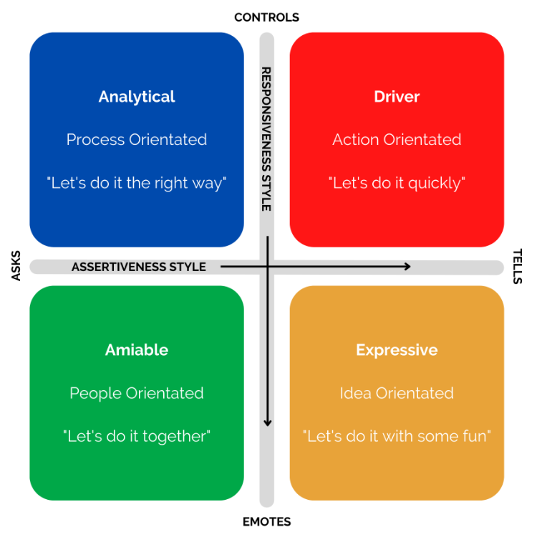
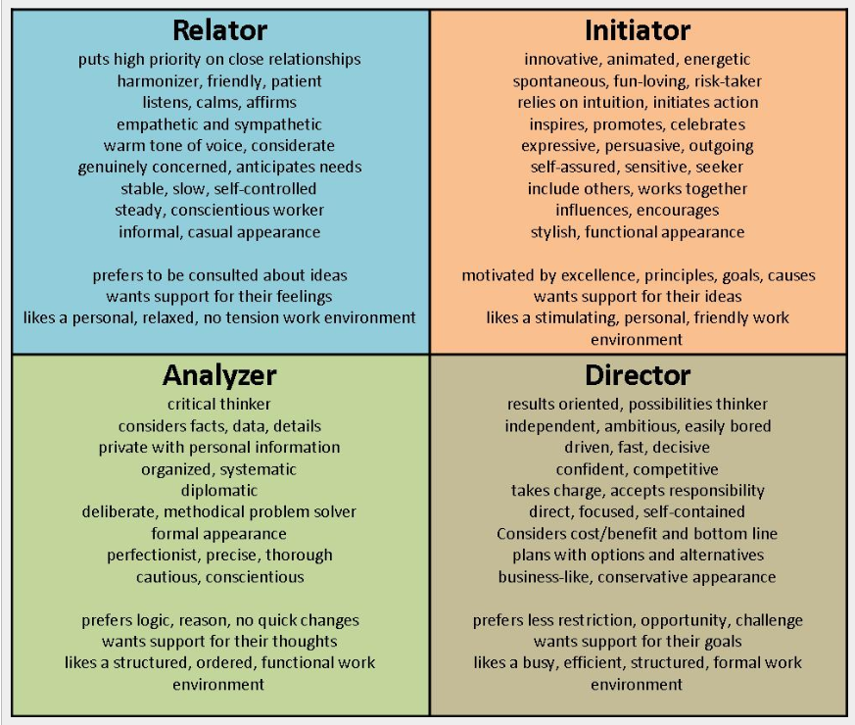
RULES OF Engagement
Understand the audience and their personal learning and communication styles
https://www.clickthrough-marketing.com/blog/merrill-reid-social-styles-model
Notes:
Multiple tools
Learn about them and work to understand others and tailor communication, education, presentations to styles or try to align with all types.
The reasons QAPI is important – can we use these to communicate to different types?

Slide 31
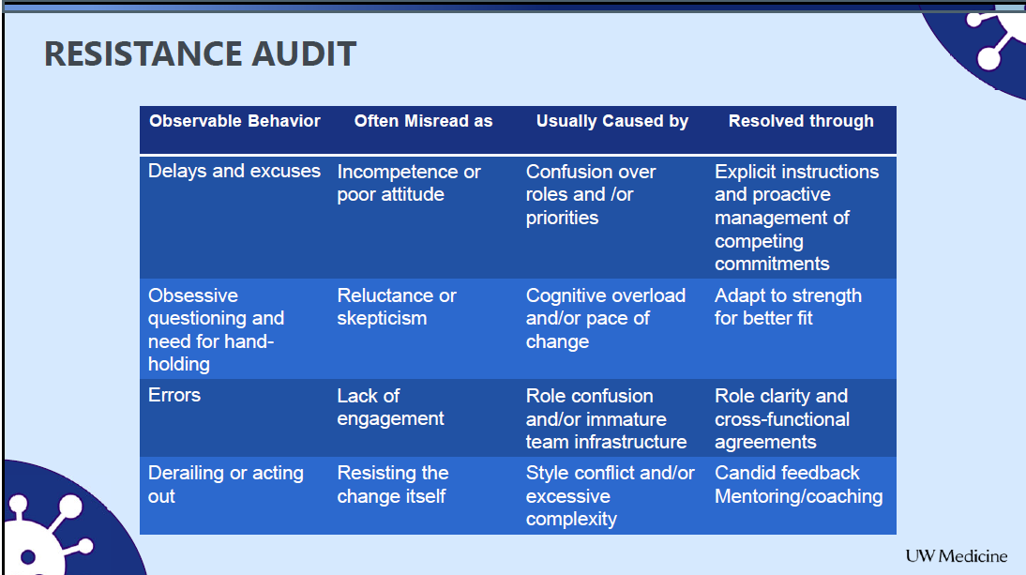
Resistance Audit
Notes:
Resistance Audit (U of W TIPS)!
Sometimes staff are taught different and its hard to change

Slide 32
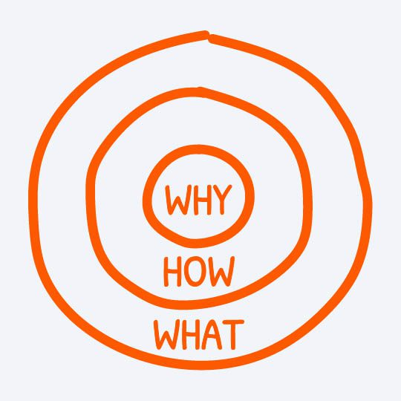
Rules of engagement
Know the WHY
WHY
Your WHY is your purpose, cause, or belief. When most organizations or people think, act, or communicate, they do so from the outside in (from WHAT to WHY).
HOW
Companies and people know HOW they do what they do and can typically communicate these processes clearly. Our HOWs are the actions we take when we are at our natural best and are living out our WHY.
WHAT
Every single company and organization on the planet knows WHAT they do.
Communicate from the inside out - People don’t buy WHAT you do, they buy WHY you do it.
Simon Sinek’s Golden Circle: https://simonsinek.com/golden-circle/
Notes:
Who has heard of, listened to, or read Simon Sinek?
He leads The Optimism Company and is a the author of Start with Why and Leaders Eat Last.
Simon’s bio says: Simon has devoted his professional life to help advance a vision of the world that does not yet exist; a world in which the vast majority of people wake up every single morning inspired, feel safe wherever they are, and end the day fulfilled by the work they do.
There is the key to engagement and the core of that is THE WHY
Use the “WHY” of:
The organization
Teams
Staff
Yourself

Slide 33
RULES OF ENGAGEMENT
CONNECT WITH STORIES
Stories can be used to communicate a problem, provide context, and present a solution. Storytelling is a science into itself and includes an arc of emotions, setting the stage of where the story takes place, who it affects, and how. (1)
Storytelling builds trust and engenders strong emotional connections. It helps your teams better understand where they fit inside your organization's vision and mission (2)
Stories help employees see your organization in a different light, and find a deeper sense of purpose in their work. (2)
Collect stories by asking employees, patients, and families to share their stories – “Share an example of a time when this process worked well or this process didn’t work well.”
(1) Applying Storytelling to Health and Healthcare, American Nurse, January 2022 https://www.myamericannurse.com/applying-storytelling-to-health-and-healthcare/#:~:text=Storytelling%20is%20a%20critical%20part,who%20it%20affects%2C%20and%20how.
(2)Susan Linder, How to use storytelling to increase employee engagement, January 2022, https://www.linkedin.com/pulse/how-use-storytelling-increase-employee-engagement-susan-lindner#:~:text=Storytelling%20builds%20trust%20and%20engenders,of%20purpose%20in%20their%20work.
Notes:
Milestone Moments Template
Personal Experiences
Patient and Family interviews / guest speakers
How else?

Slide 34

“When people are financially invested, they want a return.
When people are emotionally invested, they want to contribute.”
Simon Sinek

