Slide 1
SDOH Screening

Slide 3
Screening for Social Drivers of Health
Background | New CMS Inpatient Quality Reporting (IQR) measure
Submission | Annual numerator and denominator submission through HQR
Description | Percent of patients 18 and older admitted for an inpatient stay that are screened for all of the following health-related social needs (HRSNs):
Food insecurity
Housing instability
Transportation needs
Utility difficulties
Interpersonal safety
Additional information:
CMS is not requiring a specific screening tool be used, but all five areas of HRSN must be included. A list of suggested tools is available.
First available reporting timeline is spring 2024 (reflecting patients admitted in CY 2023)
Specifications & Frequently Asked Questions

Slide 4
Screen positive for social drivers of health
Background | New CMS Inpatient Quality Reporting (IQR) measure
Submission | Annual numerator and denominator submission through HQR
Description | Screen positive rate for social drivers of health calculated as five separate rates.
Food insecurity
Housing instability
Transportation needs
Utility difficulties
Interpersonal safety
Additional information:
Screen positive rate is NOT a measure of performance
Timeline aligns with SDOH Screening
Draft Specifications
Numerators: Number that screen positive for each of 5 HRSNs
Denominator: Total number of patients 18 or older screened for an HRSN

Slide 5
SDOH Screening Data Collection Tool
This spreadsheet includes measure specifications, key dates, and frequently asked questions regarding the Hospital Commitment to Health Equity (HCHE) measure, SDOH-1 (Screening rate) and SDOH-2 (Screen positive rate). It also includes an example of how you might track your screening rate over time to inform quality improvement efforts in your facility.
This template is a starting point to visualize the information you are required to gather, both so you can successfully meet CMS reporting requirements and also so you can begin to consider how to use these data for improvement activities within your facility.
Contact the Cynosure Health team with questions or suggestions on how to improve this tool. Email Natalie Graves - ngraves@cynosurehealth.org
Check out the Cynosure Health Social Drivers of Health Online Community for additional resources and to connect with peers: https://clic.thinkific.com/communities/Q29tbXVuaXR5LTMxODc5/

Slide 6
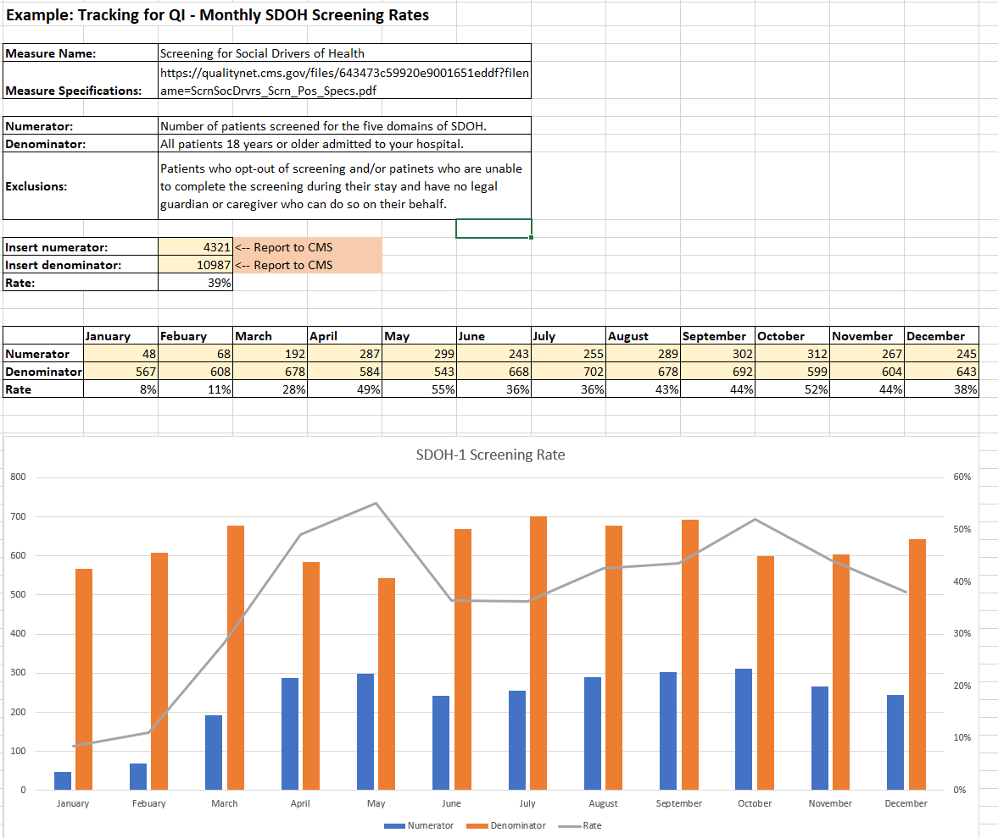

Slide 7
Questions?

