Slide 1
QIC & DON Regional meetings
October & November 2023

Slide 2
Welcome & Introductions
Welcome & Introductions

Slide 3
Today’s Agenda
MHREF Quality Programs Overview & Update
New MBQIP Measures
Social Drivers of Health (SDOH) Screening
Awards & Lunch
QAPI Engagement
QI Showcases
Open Discussion Time

Slide 4
Quality Programs Overview

Slide 5
MHREF Quality Programs (Montana Health Research and Education Foundation) currently include the Medicare Rural Hospital Flexibility Program (Flex) and the Hospital Quality Improvement Collaborative (HQIC).
MHREF Quality Programs (Montana Health Research and Education Foundation) currently include the Medicare Rural Hospital Flexibility Program (Flex) and the Hospital Quality Improvement Collaborative (HQIC).
Flex
HQIC
Future
MHREF
QUALITY PROGRAMS

Slide 6
Quality Improvement & Infrastructure
Finance & Operations
Health Equity & Population Health

Slide 7
The mission of the Montana Rural Healthcare Performance Improvement Network (PIN) is to develop and provide a collaborative system, which will enable small rural hospitals to have the ability to deliver quality care and achieve customer satisfaction.

Slide 8
Rural Hospital Flexibility Program
Federal cooperative agreement distributed by the Health Resources and Services Administration (HRSA) and the Federal Office of Rural Health Policy (FORHP) as a result of the designation of the CAH model via the 1997 Balanced Budget Act.
Each state is designated a grantee by the Governor. In MT, the grantee is the Office of the Inspector General (OIG) at DPHHS. Leslie Howe is our partner and program manager at the OIG Office.
MHREF has been awarded the Flex contract since the inception of the program and administers most of the Flex activities. OIG retains fiscal oversight; partners with the Public Health & Safety Division for operational improvement, population health improvement and EMS improvement activities; and is responsible for program evaluation and submissions to HRSA.

Slide 9
Rural Hospital Flexibility Program
FY 2023 September 1 – August 31
As the HRSA awardee, DPHHS is pleased to announce Flex got another raise this year due to both an increase in appropriated funds and higher than usual offset amounts from FY 2021. This amounts to a total funding amount of $928,510 for FY 2023.
We will be writing a competing application this winter for the next 5-year funding cycle that will begin September 1, 2024.

Slide 10
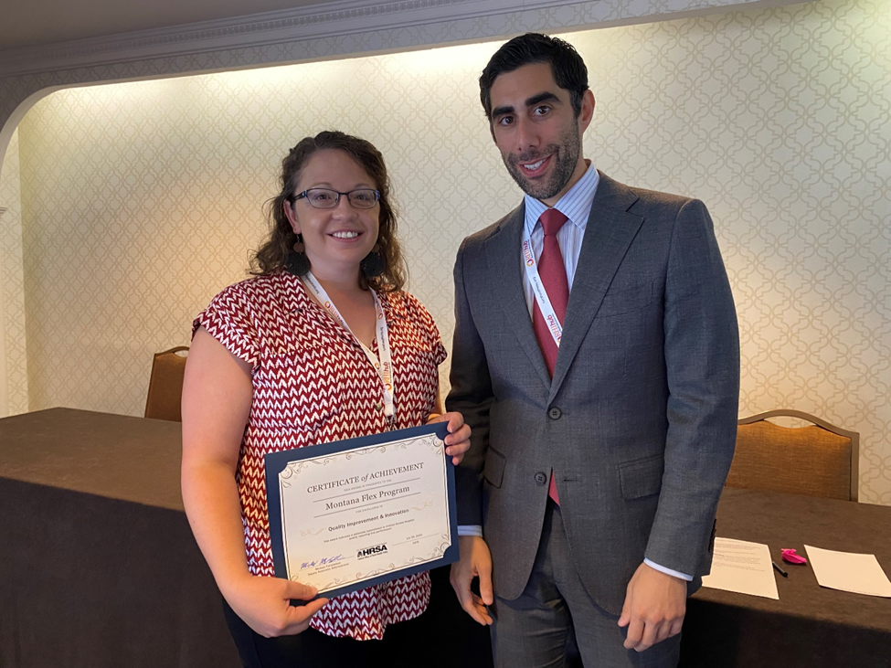
Quality Improvement & Innovation
The Montana Flex Program was recognized for excellence and innovation in quality improvement activities that are a key program area of the Flex program at the Annual Flex Reverse Site Visit in July.
This award is presented to Flex Programs that exemplify the collaborative and innovative spirit of the MBQIP (Medicare Beneficiary Quality Improvement Program).
Notes:
We are proud to have been recognized by federal program partners for the Flex Program. However, recognition like this is not possible without the engagement, efforts, and trust of Montana Hospitals. So thank you!

Slide 11
Hospital Quality Improvement Collaborative
Center for Medicare & Medicaid Services (CMS) funded project to partner with hospitals across the country in rural, critical access, and urban settings that provide care for vulnerable populations
Four-year CMS Contract for September 18, 2020 - September 17, 2024
Past iterations include:
HIIN: Hospital Improvement Innovation Network (2016-2019)
HEN and HEN 2.0: Hospital Engagement Network (2011-2015) Montana is part of the Convergence HQIC through Cynosure Health.
In all iterations, Cynosure Health has been MT’s subject matter expert and has strong relationships with MT Hospitals.
Strong focus on patient and family engagement for equity.

Slide 12
HQIC Resources through 09/2024
Cynosure Learning & Improvement Connection (CLIC) Virtual Learning Platform
Free Courses plus CE credit courses and Fellowships and Residencies
Cynosure QI Connection List Serve across the 300 hospitals
Tools & resources for quality and safety improvement
Curated webinars dedicated to improvement within HQIC topic areas
1:1 coaching from Subject Matter Experts
SDOH Community for peer learning (Social Determinants of Health)
Patient Family Partner Hub

Slide 13
Growth
MHA is continually watching for funding opportunities that can help supplement and expand valuable activities and resources.
MHREF Quality Programs has submitted for Civil Money Penalties (CMP) funding for Nursing Homes for the following projects. Applications are currently held up at CMS.
Building Blocks of Quality Improvement
Quality Assurance and Performance Improvement (QAPI) Programs
Patient & Family Engagement
Progressive Mobility

Slide 14
Activity Updates
Rearview and future focus
Notes:
Instead of going through every project and the satisfaction scores, we want to share with you some wins, what might be of most interest to you in the next year, and what we’ve learned. So we will take a rearview look into the last program year, as well as a focused look into 2023 and 2024.
We have many more activities throughout the year than we will touch on. Additional information on all activities can be found in the Program Catalog in your packet. It will also be posted on the PIN Website.

Slide 15
Quality Improvement
17 Site Visits with CAH Quality Staff (27 hospitals total between the team)
6 new Lean Healthcare Certified Yellow Belts
56 CAH staff at MHA Health Summit
All hospitals shown improvement in QI Roots project
Cross-state collaborations
Continue Cross State Collaborations
Certified Professional in Healthcare Risk Management
Quality Improvement Roots
PIN Quality Awards
QIC/DON Regional Meetings
Notes:
17 Site Visits with CAH Quality Staff between all staff and program areas 27 different hospitals were visited.
6 new Lean Healthcare Certified Yellow Belts via our rotating certification program.
Financial support for 56 CAH staff to attend the MHA Health Summit. PLUS financial support of programming at the Summit.
QI Roots – our annual quality improvement project – ended with all participating hospitals implementing a change idea and showing improvement.
Cross-state collaborations provide opportunities to split the cost and resources for education and support with other state programs, and broadens networking and perspectives for our hospitals. The value of these collaborations has been recognized by Flex funders, the Federal Office of Rural Health Policy and Lindsay will be speaking with other states at the National Rural Health Association meeting next week in Kansas City.
We will continue to identify opportunities for cross state collaborations
Our certification prep course continue to support the workforce in our CAHs. This program year, we will facility the Certified Professional in Healthcare Risk Management
QI Roots Program isn’t just for Quality Coordinators, its for all CAH staff that would benefit from hands on learning in quality improvement.
14 CAHs will receive a PIN Quality Award for work done in the 2022-2023 program year. The award criteria includes consistent data reporting, engagement with others, and a quality improvement project. We will be re-evaluating Award Criteria for this coming program year, using inspiration from New Mexico and Arizona Quality Programs to focus more on performance improvement work – as we know the criteria of data reporting and engagement doesn’t always reflect the hard work being done on site and there are circumstances out of anyone's control, such as staff turnover, that impacts those.
Regional Meetings – registration has gone out and please encourage your staff to attend! These are great networking opportunities!

Slide 16
Finance & Operations - CAH
17 Site visits to CAH CEO/CFO or Rural Health Clinics
300+ attendees at Billing & Coding Webinar Series
Lean Internships with MSU’s School of Industrial Engineering: All participating CAHs showed significant improvement from the project and reported significant satisfaction!
51 CAH staff at the 2022 CAH CEO Meeting & Montana Healthcare Conference
FY 2023 CAH Peer Group Update (list in packets)
Continue education for billing & coding support for CAH and RHC
Continue education for survey & regulatory preparedness for CAH and RHC
Lean Internship Applications out in early 2024. (Session G4 at 10:30 AM Friday)
Notes:
JACK

Slide 17
Finance & Operations - CAH
Advanced Trauma Life Support - 20 course, 293 providers trained, and 6 home grown new instructor candidates
5 Advanced Trauma Life Support (ATLS) provider classes will be offered in 2023-2024
Advanced Burn Life Support virtual course will be offered for physicians and nonphysicians unable to attend the classes offered by other entities in the state
Notes:
LESLIE

Slide 18
Finance & Operations - RHC
EideBailly RHC Financial Indicators Study
Increased participation in POND (Provider Operations National Database)
Increased in engagement with provider based rural health clinics.
Program now a member of National Association of Rural Health Clinics (NAHRC)
RHC Financial Indicators Regional Meetings (10/31 & 11/2)
Begin development of Rural Health Clinic Network in partnership with Montana Office of Rural Health.

Slide 19
Emergency Medical Services
Time Sensitive Injury and Illness (TSII) State and Regional Meetings
Offered by Flex using the additional funds received in FY22.
15 CAH communities and 6 CAH-owned ambulance agencies represented at the trainings.
Of EMS agency attendees, 99 responded to the evaluation with scores of mostly “excellent”
Montana reporting numbers for TSII Quality Improvement measures are currently close to or higher than the national performance level.
In FY23 DPHHS and Flex will expand on the FY22 training by offering TSII training with a quality improvement focus.
Montana has the highest percentage of counties with ambulance deserts in the country. It is hoped that Flex efforts can get the needle moving in the right direction.
Map of participating counties in the TSII Meetings is on the next slide.
Notes:
LESLIE

Slide 20
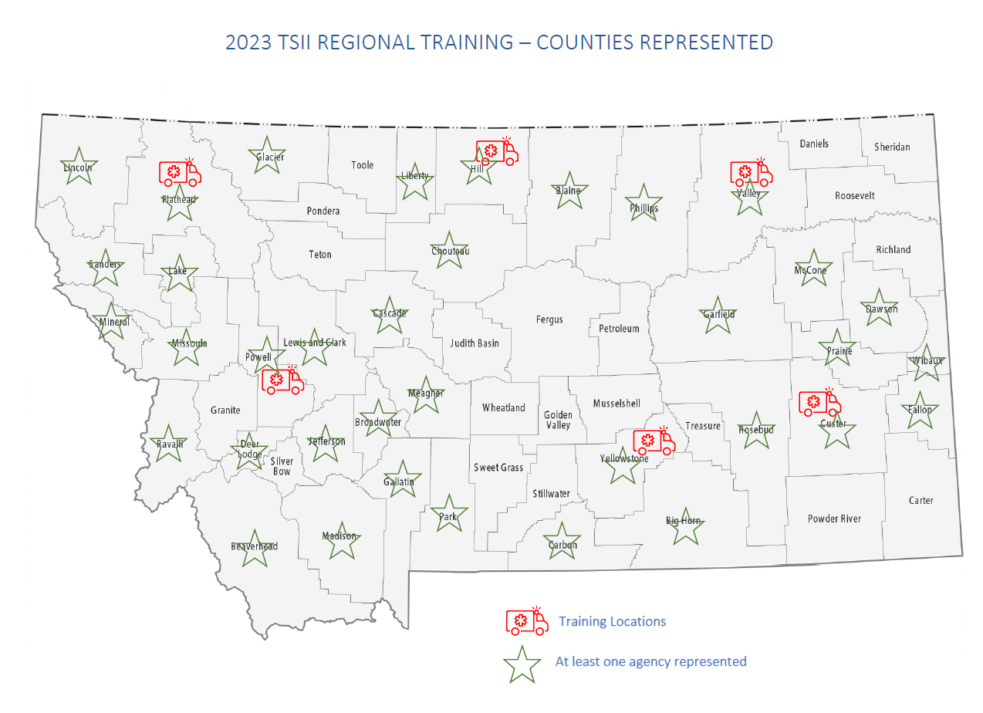
Notes:
LESLIE

Slide 21
Population Health & Health Equity
Certified Lactation Counselor (CLC) Scholarships
Offered since Flex Program Year 1 (2018-2019)
35 applicants for 10 scholarships in FY22
number of CLCs at CAHs in Montana has increased substantially since the inception of this program in Y1.
Certified Lactation Counselor (CLC) Scholarships
An additional 5 scholarships for a total of 15 will be offered in FY23, and all 15 participants will be able to receive participant support to attend the annual breastfeeding collaborative.
DPHHS and Flex are happy to provide this valuable training to CAH staff. The results exceeded our 5-year goal of increasing the percentage of trained hospital nurses with clinical competency in breastfeeding support/lactation management to 50% after only 2 years.
Worksite Wellness
Worksite Wellness activity will continue coaching for 8 participating CAHs this year. Flex will provide an opportunity for each participating CAH to take advantage of additional funding for participation in Walk with Ease and Live Life well programs.
Notes:
LESLIE

Slide 22
Population Health & Health Equity
Cross-state Collaboration on Social Drivers of Health (SDOH)
An “All you need to know” to get started on SDOH Screening
SDOH Screening and Support Series – Cross State Collaboration with Idaho CAHs
Implementation Plan financial support – Applications in your packets
Notes:
JENNIFER
*Social Drivers of Health Screening* New measure for MBQIP for the Flex Program starting in September 2024. Not a CMS requirement. It is still important as this really is the underlying driver of many outcomes for patients.
Series – Outcomes driven series with action items for participating hospitals to move forward. Coaching provided.
Webinar #1 – Hospital Equity the “Big Picture”
Webinar #2 – Building Trust to Strengthen SDOH Data Collection
Webinar #3 – Deep dive on data collection plans and practices – partnering with patients
Webinar #4 – Using Data to Drive Improvement – Analyzing SDOH Screening Data, Identifying Disparities, and Basic Interpretation
Webinar #5 – Group Discussion: Deep dive on challenges and lessons from initial data collection and analysis
Webinar #6 – Getting to Action - Discover new strategies to build partnerships and trust with community members and community-based organizations
^^this is where the rubber meet the road.
Now that I have everyone’s blood pressure up…. ;)
I want to acknowledge the very real anxiety around the screening and the “Then what”.
Hospitals all over the country are concerned about screening and then what should the hospital/staff do if a person screens positive in any area. This is largely unique to the hospital and the community as we know it might be difficult to get access to help in rural communities. While I don’t have an answer for you, I want to share some perspectives that might help focus intentions and expectations in this area.
The CMS requirement is 5 domains. Hospitals can start small with these 5 and research resources in the immediate or surrounding communities on how to connect patients.
This domains include “Food Insecurity, Housing Instability, Transportation Needs, Utility Difficulties and Interpersonal Safety. You might me doing this in some way already – its just not called SDOH Screening.
Test the screening process and scripts. with small focus groups before rolling out facility wide. Find what your staff is comfortable with. Take advantage of our SDOH series to network with other hospitals and learn from them.
Set Realistic Expectations. Yes, the hospital might not be able to immediately help the problem. However, collecting this information is respectful to the patient in acknowledging their unique lived experiences, the information can inform the care plan to set the patient up for better success after discharge (St Lukes Story). And this data is incredibly valuable for community resources – it validates the need for funding and resources within the community – see it a another perspective of your CHNA. The CHNA tells you what the community thinks, the SDOH screening tells what the community is actually experiencing.
Look at the “requirements” and then as an organization identify your own “why” around screening and communicate that to your patients. Let this support your mission.
This is new to all hospitals across the country, and it is the goal of the MHREF Quality Programs to harness that shared experience and work together to support our MT hospitals.

Slide 23
Quality Measure Trends (MBQIP)
Benchmark: 100%
Trend: Higher is better
The most common missed elements are:
Home Medications (89% Avg)
Allergies/Reactions (90% Avg)

Slide 24
Quality Measure Trends (MBQIP)
Benchmark: 100%
Trend: Higher is better
The most common missed elements are:
Drug Expertise
Tracking

Slide 25
Quality Measure Trends (MBQIP)
Benchmark: 100%
Trend: Higher is better

Slide 26
Quality Measure Trends (MBQIP)
Benchmark: 84 Minutes
Trend: Lower is better

Slide 27
Quality Measure Trends (MBQIP)
Benchmark: 100%
Trend: Higher is better

Slide 28
Quality Measure Trends (MBQIP)
Benchmark: 36 Minutes
Trend: Lower is better

Slide 29
Quality Measure Trends (HQIC)
Trend: Lower is better
Orange: State Baseline
Blue: State Performance
Gray: HQIC CAHS

Slide 30
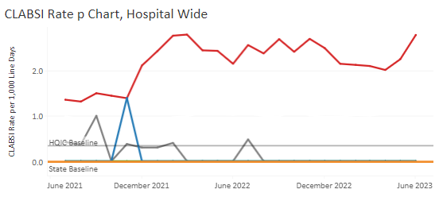
Quality Measure Trends (HQIC)
Trend: Lower is better
Orange: State Baseline
Blue: State Performance
Gray: HQIC CAHS

Slide 31
Quality Measure Trends (HQIC)
CMS is measuring this value
These values show us where the high readmission risk is
Trend: Lower is better Orange: State Baseline
Blue: State Performance
Gray: HQIC CAHS

Slide 32
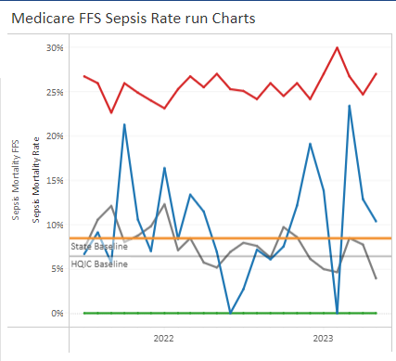
Quality Measure Trends (HQIC)
Trend: Lower is better
Orange: State Baseline
Blue: State Performance
Gray: HQIC CAHS

Slide 33
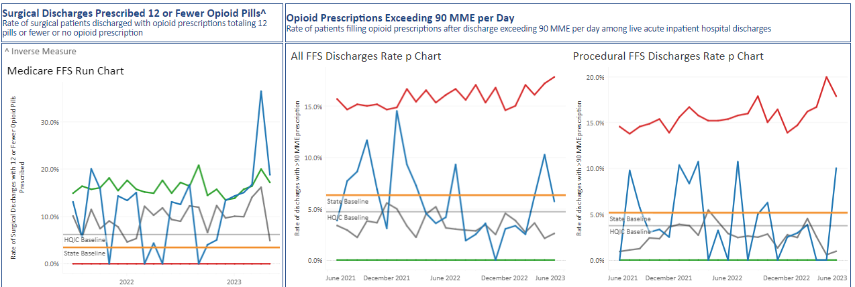
Quality Measure Trends (HQIC)
Orange: State Baseline
Blue: State Performance
Gray: HQIC CAHS

Slide 34
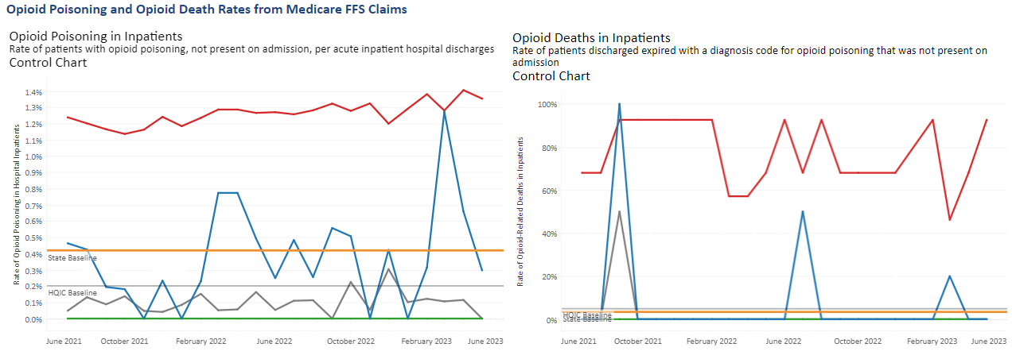
Quality Measure Trends
Trend: Lower is better
Orange: State Baseline
Blue: State Performance
Gray: HQIC CAHS

Slide 35
MHREF
Office of Inspector General
Jennifer Wagner Director of Quality Programs
Jennifer.wagner@mtha.org
(406) 457-8000
Jack King Finance & Operations Program Specialist jack.king@mtha.org
(406) 457-8016
Lindsay Konen
Quality Improvement Programs Specialist
Lindsay.Konen@mtha.org
406-457-8002
Leslie Howe Flex Program Manager
LHowe@mt.gov
(406) 444-9519
Michelle Truax Inspector General MTruax@mt.gov
(406) 444-4120
Notes:
Before we get started, I’d like to introduce the organizations and team members that support the MHREF Quality Programs.
When I say your name, please stand! At MHREF/MHA we have me, Jack, Lindsay, Shani. At DPHHS OIG we have Leslie, Michelle.
Our program has a lot of irons in the fire and these individuals work incredibly hard to keep them all going and provide meaningful activities to you and your hospitals. Please give them a round of applause.

