Slide 1
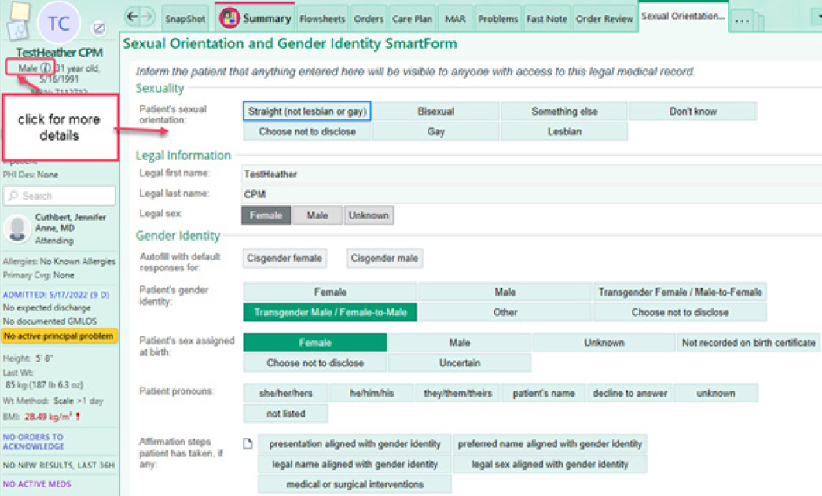
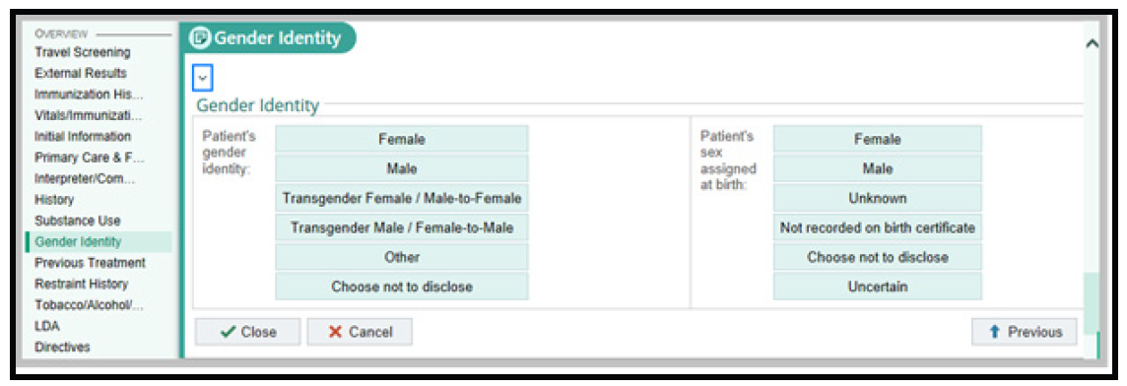
Safety Spotlight
June is Pride Month
Nursing can enter details from the Admission Navigator
Parkland Health provides care with dignity to all people who enter our doors. This includes those who are part of the LGBTQ+ Community. Part of the dignity and respect we provide should include avoiding misgendering patients. Remember, a person does not need to undergo any medical intervention to be considered a transgender man or transgender woman.
To enter specifics regarding Sexual Orientation and Gender Identity is as easy as clicking on the Epic Storyboard.

