Slide 1
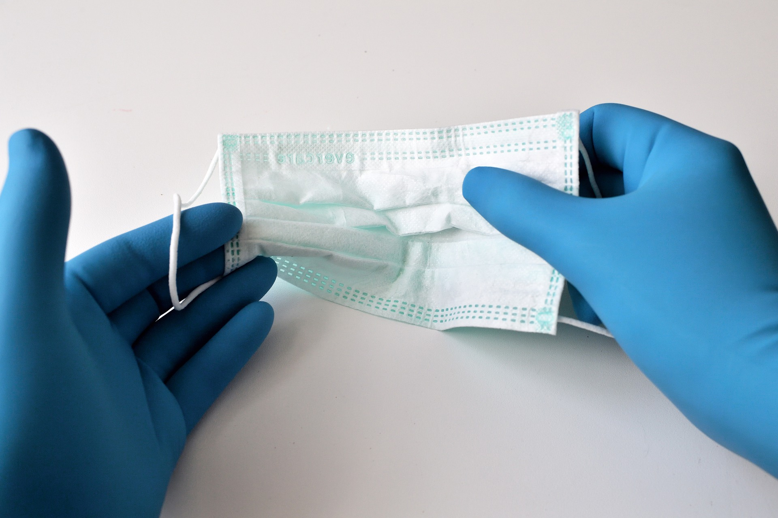
Facility
Project Title
Notes:
Right click -> Format Background -> Replace it with your picture ☺

Slide 2
PLAN
Background: Why did you choose this project? Why was it important to work on?
Enter here
Project Aim: What is your goal and how will it be measured?
Enter here

Slide 3
DO
What did you do to make a change?
Enter your small tests of change here.
If you used driver diagrams or other tools to determine interventions, please email those separately and Jen will place in the slides.

Slide 4
DO
Did you involve patient and family partners in your work? How?
Enter here

Slide 5
Study
 | BASELINE VALUE | REMEASURE VALUE | Did you improve?
METRIC #1
METRIC #2
Add more lines if additional metrics
Explain the changes seen based on the data above or experiences; knowing some benefits may not be measurable in numbers.
Enter Here
NOTE: Only the what is written in the second table and rate of improvement will be displayed in the poster and not raw baseline and remeasurement data.

Slide 6
ACT
Adopt, Adapt, or Abandon?
Changes to be made?
Lessons Learned?
Next steps or future goals?
Conclusion

Slide 7
Project Acknowledgements
Project Team Members Name & Titles
Paste Your Facility Logo here

