Slide 1
Cultivating Roots of Quality Improvement
Session 6:
No Blame, No Shame in Patient Safety and Adverse Events
Engaging Patients and Families in Quality Improvement
July 13, 2022
Notes:
Right click -> Format Background -> Replace it with your picture ☺

Slide 2
Chat Box Roll Call
Facility Name
Your Name + any Team Members with you
Paper clips or staples?
Cabinet Peaks Medical Center
Central Montana Medical Center
Community Hospital Of Anaconda
Fallon Medical Complex
Garfield County Health Center
Missouri River Medical Center
Frances Mahon Deaconess Hospital
Bitterroot Health – Daly Hospital
St. Luke Community Hospital
Holy Rosary Health Care

Slide 3
Who is to blame when a medical error occurs?

Slide 4
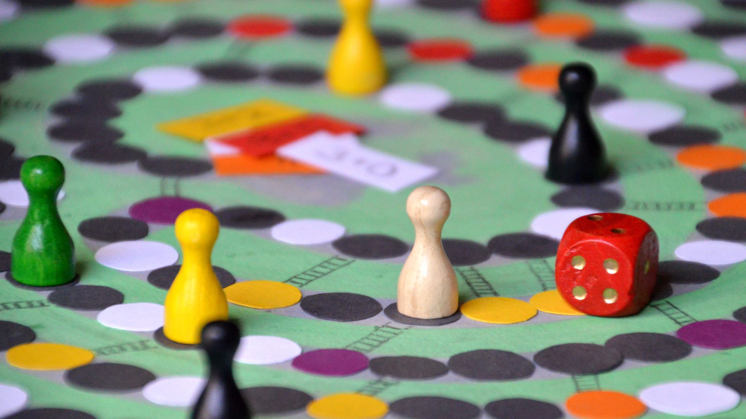
Avoid the ‘name blame and shame game’

Slide 5
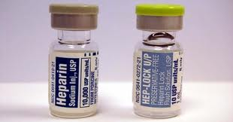
From Error to Harm

Slide 7
A Closer Look at Error
Unsafe acts are categorized as either errors or violations.
An error is a lapse, slip, or a mistake.
When an action fails to go as intended, the error is called either a slip (if it is observable – like pushing the wrong button on a piece of equipment) or a lapse (if it is unobservable – like forgetting to give a medication).
When an action goes as intended but is the wrong one, it is called a mistake (such as a diagnostic error).
A violation is a deliberate deviation from an operating procedure, standard, or rules.
Notes:
An example of a slip is accidentally pushing the wrong button on a piece of equipment: You and others can see that you pushed the wrong button.
An example of a lapse is some form of memory failure, such as failing to administer a medication: No one can see your memory fail, so the error is not observable.

Slide 8
Why do mistakes happen?
Human error
Negligence
System error

Slide 9
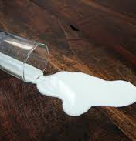
From Error to Harm
Human error
Behavioral choice
At risk behavior
Reckless behavior

Slide 10
Human Error
Inadvertently doing other than what should have been done:
a mental slip, lapse, or mistake
not a choice

Slide 11
Behavioral Choice
Intentional acts undertaken by the free exercise of one’s judgment.
Purposeful behavior intentionally employed while engaging in our day-to-day activities.

Slide 12
At-Risk Behavior
Behavior that increases risk where risk is not recognized or is mistakenly believed to be justified

Slide 13
Reckless Behavior
A BEHAVIORAL CHOICE to consciously disregard a substantial and unjustifiable risk.
The risk is perceived
The risk is substantial
The action is intentional
Awareness others are not engaging in the same behavior

Slide 14
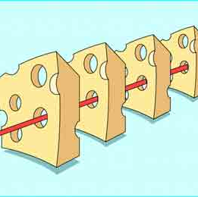
Defining the Problem
Most errors are made by good (but fallible) people working in often dysfunctional systems
Swiss cheese model when the holes align . . . errors occur
Need to fix our systems to catch “the inevitable lapses of mortals”

Slide 15
Preparation of the Medication
MD incorrectly read the pt weight and wrote the wrong order.
The second pharmacist Tech did not question the order.
Pharmacy did not verify or question the order.
The nurse did not express concerns or question the order.
No Pharmacy protocol for the med
Profession
Team -Clinical Support System
Organization Structure
Individual and
Management
System
Communication
System
The latent failure model of complex system failure - modified from James Reason, 1991
Notes:
Example of the system failing in numerous steps to result I a failure at the sharp end of care.

Slide 16
Latent Conditions and Active Failures
Active failures: we see them happen – the point at which the wrong drug or treatment gets to a patient, the point at which the wrong switch is turned off
Latent failures are made by people whose tasks are removed in time and space from operational activities, e.g., designers, decision makers and managers.
Examples of latent failures are:
• Poor design of plant and equipment;
• Ineffective training;
• Inadequate supervision;
• Ineffective communications;
• Inadequate resources (e.g., people and equipment); and
• Uncertainties in roles and responsibilities.
Notes:
Teenage driver example

Slide 17
Key Concept
Errors are the result of multiple failures in a process
Known errors are only a small fraction of potential harm
How do we promote reporting of ‘near misses’?
Notes:
We can’t just focus on known/reported errors – we must find a way to learn about near misses and other potential harm

Slide 19
Key Concept
Humans make mistakes, and relying on memory is a great way to ensure mistakes will be make
Checklists have been found to reduce errors significantly

Slide 20
Checklists to Reduce the Potential for Accidental Harm
Notes:
IHI has defined harm as “unintended physical injury resulting from or contributed to by medical care that requires additional monitoring, treatment, or hospitalization or that results in death.”
Patient safety innovators and patients have suggested a broader definition of harm, including three types of injury that have not traditionally been included in the definition of harm:
Errors of omission (what providers fail to do)
Psychological harm
Financial harm in the form of unaffordable care
A project in Michigan, US, developed a comprehensive safety system for reducing catheter-associated bloodstream infections (CLABSIs).
It included a checklist, supply carts, and explicit roles for the various members of a care team.
The system showed that hospitals could nearly eliminate CLABSIs, which people once thought to be an inevitable complication of care.
The history of medicine shows that many harms that used to be accepted are actually preventable, including high doses of chemotherapy, radical mastectomies, and overuse of antibiotics that leads to resistance.

Slide 21
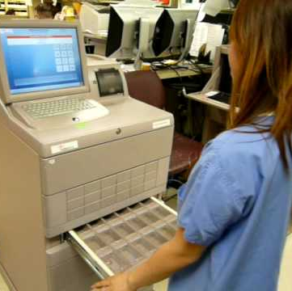
Constraints, Forcing Functions and Redundancies
Constraints make it difficult to complete a task. A constraint can be defined as the state of being checked, restricted, or compelled to avoid or perform some action.
Notes:
In the inpatient setting, the removal of concentrated electrolytes, which are lethal when administered undiluted, from patient care units is a constraint. By making a nurse travel to another location to obtain concentrated electrolytes, organizations can restrict nurses from using the electrolytes without proceeding through the appropriate checks and reduce the possibility that someone will inadvertently and mistakenly administer an undiluted lethal dose. It is not impossible to obtain the product; it is just more difficult.
Despite its potential usefulness, a double check can also present an opportunity for error. Two people can be prone to make the same mistake for the following reasons:
The second person may not be as attentive to the checking as he or she should be.
The second person can be influenced by the first person to see what he or she would expect.
Double checks can be overused, making people less likely to take them seriously.
Redundancies are frequently seen as a double check, when one person checks the work of another. This is very common in health care and in some cases a requirement. To be effective, the double check must be independent and follow a set of steps.

Slide 22
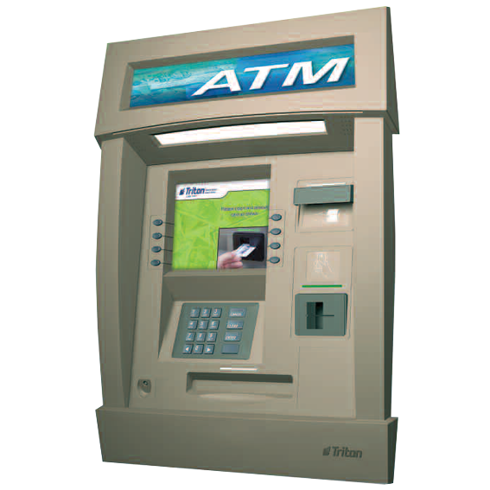
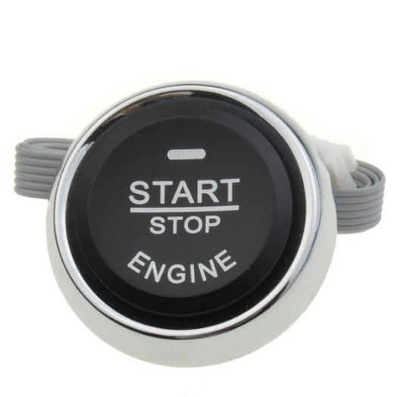
Constraints, Forcing Functions and Redundancies
Forcing functions make it impossible to do a task incorrectly. They create a hard stop that you cannot pass unless you change your actions.
Notes:
In the inpatient setting, the removal of concentrated electrolytes, which are lethal when administered undiluted, from patient care units is a constraint. By making a nurse travel to another location to obtain concentrated electrolytes, organizations can restrict nurses from using the electrolytes without proceeding through the appropriate checks and reduce the possibility that someone will inadvertently and mistakenly administer an undiluted lethal dose. It is not impossible to obtain the product; it is just more difficult.
Despite its potential usefulness, a double check can also present an opportunity for error. Two people can be prone to make the same mistake for the following reasons:
The second person may not be as attentive to the checking as he or she should be.
The second person can be influenced by the first person to see what he or she would expect.
Double checks can be overused, making people less likely to take them seriously.
Redundancies are frequently seen as a double check, when one person checks the work of another. This is very common in health care and in some cases a requirement. To be effective, the double check must be independent and follow a set of steps.

Slide 23
A forcing function does not have to involve device design

Slide 24
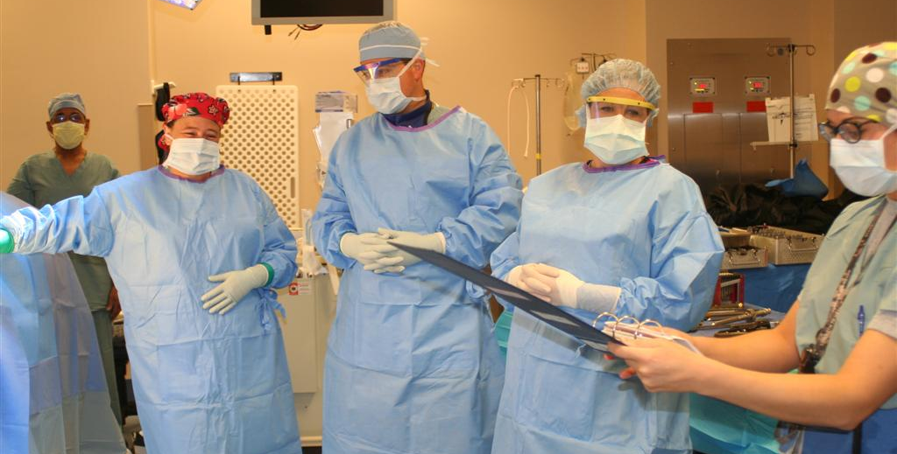
Constraints, Forcing Functions and Redundancies
A redundancy is a system design that includes a duplicate, but not necessary to complete, step or component.
Notes:
In the inpatient setting, the removal of concentrated electrolytes, which are lethal when administered undiluted, from patient care units is a constraint. By making a nurse travel to another location to obtain concentrated electrolytes, organizations can restrict nurses from using the electrolytes without proceeding through the appropriate checks and reduce the possibility that someone will inadvertently and mistakenly administer an undiluted lethal dose. It is not impossible to obtain the product; it is just more difficult.
Despite its potential usefulness, a double check can also present an opportunity for error. Two people can be prone to make the same mistake for the following reasons:
The second person may not be as attentive to the checking as he or she should be.
The second person can be influenced by the first person to see what he or she would expect.
Double checks can be overused, making people less likely to take them seriously.
Redundancies are frequently seen as a double check, when one person checks the work of another. This is very common in health care and in some cases a requirement. To be effective, the double check must be independent and follow a set of steps.

Slide 25
Technology Can Reduce Errors, BUT…
The interface between humans and machines can also lead to errors.
Technology also provides us with new forms of error

Slide 26
Let’s revisit this

Slide 27
ISMP link
Resources Related to Neuromuscular Blocker and ADC Errors | Institute For Safe Medication Practices (ismp.org)

Slide 28
Group Discussion
How are you measuring psychological safety and reporting of adverse events?

Slide 29
Family Involvement Menu

Slide 30
Improving Care Transitions

Slide 31
Other Approaches?

Slide 32
Schedule
Date
July 27 | Project Office Hours: Come to talk through your project or receive coaching on completion of Poster Slides
August 1 | Send completed Poster Slides to Jen. Hospitals to present on 8/3.
August 3 | Celebration & Sharing: Present on Poster Slides
Contact
Jennifer Wagner, CPHQ | Barb DeBaun, MSN, RN, CIC
MT Flex & HQIC Programs | Cynosure Health
jennifer.wagner@mtha.org | bdebaun@cynosurehealth.org
Project Website | https://mtpin.org/qiroots/

Slide 33
Thank You For Your Time
See you soon…

