Slide 1
Swing Bed Quality Improvement Project
User Group Call
Choice of Post-Acute Providers
October 15, 2021
Welcome! We will begin shortly while everyone gets logged in!
Notes:
Right click -> Format Background -> Replace it with your picture ☺

Slide 2
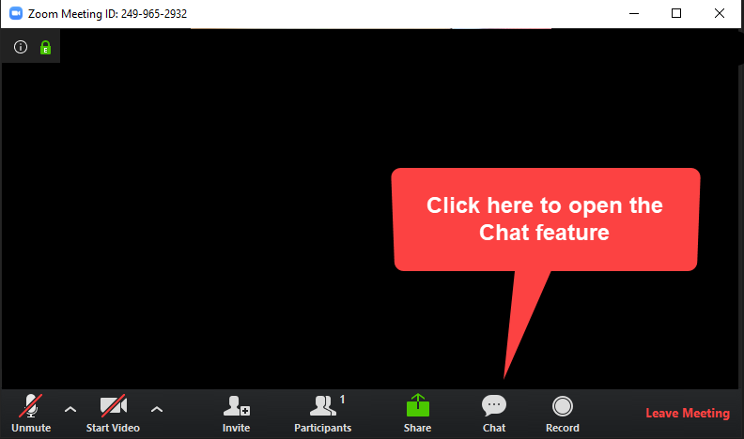
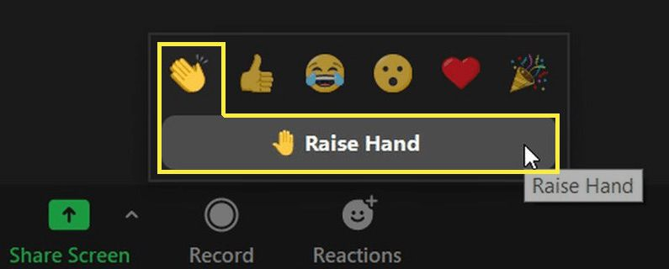
Use the chat box.
Raise your hand and one of our team members will call on you.
Unmute and speak up!
Turn your camera on when speaking (if possible). We love your face!!
When you speak the first time provide your name and facility.
Notes:
We want our attendees to engage and ask questions. Instructions are here. If one of us is speaking, the others should monitor chat and hand raises.

Slide 3
Virtual Roll Call
Name
Facility
Favorite thing about Friday?
Notes:
Virtual Introductions in the chat box while we begin.
Name, Role, and Facility and a piece of gratitude to restart the afternoon!
What can they expect today?
Program overview on upcoming projects and activities for this next grant year.
What do we expect?
Chime in, ask questions, provide input

Slide 4
Choice of Post-Acute Providers
In December of 2019, the Centers for Medicare & Medicaid Services (CMS) published the Burden Reduction and Discharge Planning Final Rules Guidance and Process. The requirements include providing the patient a choice of post-acute care providers along with quality and resource data.
C-1425 (Rev. ) (8) The CAH must assist patients, their families, or the patient’s representative in selecting a post-acute care provider by using and sharing data that includes, but is not limited to, HHA, SNF, IRF, or LTCH data on quality measures and data on resource use measures. The CAH must ensure that the post-acute care data on quality measures and data on resource use measures is relevant and applicable to the patient’s goals of care and treatment preferences.
Federal Register
Finally, for CAHs, we proposed at § 485.642(c)(8) to require that CAHs assist patients, their families, or their caregiver's/support persons in selecting a PAC provider by using and sharing data that includes, but is not limited to, HHA, SNF, IRF, or LTCH, data on quality measures and data on resource use measures. We would expect that the CAH would be available to discuss and answer patients and their caregiver's questions about their post-discharge options and needs. We would also expect the CAH to document in the medical record that the PAC data on quality measures and resource use measures were shared with the patient and used to assist the patient during the discharge planning process.

Slide 5
Choice of Post-Acute Providers
Federal Register
Comment: One commenter stated that the requirement to utilize data on quality measures and data on resource use measures could be utilized to discourage the use of CAH swing beds in rural communities. Since the CAH swing bed program does not have to report data on its performance, referring facilities will list CAH Swing Bed on their referral list delivered to patients, but would have no data to include on the list. The commenter suggested that we require referring facilities to note on their discharge provider list that CAH swing beds are not required to report data similar to freestanding SNFs.
Response: The CAH's responsibility is to advise and assist patients with their choices based on quality data and the patient's goals of care and treatment preferences. As such, we do not believe that any provider will be disadvantaged with this requirement.

Slide 6
Choice of Post-Acute Providers
St John’s Lutheran Home. Billings, Montana
Overall Rating – 5 STARS Overall Rating: The overall rating is based on a nursing home's performance on 3 sources: health inspections, staffing, and quality of resident care measure
Short Stay Quality of Resident Care – 5 STARS Short-stay Quality of Resident Care. The short-stay quality of care rating reflects the quality of care delivered to temporary residents, and whose typical goal is to improve their health status so they can return to their previous setting, like their home. Percentage of short-stay residents who were re-hospitalized after a nursing home admission Percentage of short-stay residents who have had an outpatient emergency department visit Percentage of short-stay residents who got antipsychotic medication for the first time Percentage of residents with pressure ulcers/pressure injuries that are new or worsened Percentage of short-stay residents who improved in their ability to move around on their own Percentage of short-stay residents who needed and got a flu shot for the current flu season Percentage of short-stay residents who needed and got a vaccine to prevent pneumonia Percentage of residents whose medications were reviewed and who received follow-up care when medication issues were identified Percentage of SNF residents who experience one or more falls with major injury during their SNF stay Percentage of SNF residents whose functional abilities were assessed and functional goals were included in their treatment plan Percentage of residents who are at or above an expected ability to care for themselves at discharge Percentage of residents who are at or above an expected ability to move around at discharge Change in residents' ability to care for themselves Change in residents' ability to move around Rate of successful return to home and community from a SNF Rate of potentially preventable hospital readmissions 30 days after discharge from a SNF Medicare Spending Per Beneficiary (MSPB) for residents in SNFs
Staffing – 5 STARS Higher staffing levels in a nursing home may mean higher quality of care for residents. Staffing hours of different types of staff are reported by nursing homes, and are used to calculate a ratio of staffing hours per resident per day. The staffing rating is based on these measures: 1) Registered Nurse (RN) hours per resident per day; and 2) total nurse staffing (including RN, licensed practical nurse (LPN), and nurse aide) hours per resident per day Average number of residents per day Total number of licensed nurse staff hours per resident per day Registered Nurse hours per resident per day LPN/LVN hours per resident per day Nurse aide hours per resident per day Physical therapist staff hours per resident per day

Slide 7
Choice of Post-Acute Providers
Quality Measures
The Montana Flex program is collecting at least one quality measure that would be appropriate to share with patients, percent return to previous residence.
You may want to review the measures on Nursing Home Compare and see if any would be relatively easy to duplicate. However, if you do choose any of these measures it will be important that you have a standardized data definition.
You might also consider the percentage of multi-disciplinary care plan goals met by discharge
Resource-Use Measures
The easiest resource measures will be to use those that you are already collecting for Montana Flex program:
Percentage of swing bed discharges readmitted in 30 days
Percentage of total readmissions to inpatient in 30 days
Percentage of total readmission to swing beds in 30 days
Percentage of total readmissions to observation in 30 days
You may want to choose the more aggregated measure such as percentage of swing bed discharges readmitted in 30 days.
Other Measures
Nurse Staffing
Patient Satisfaction
In the end, since there is no publicly available Swing Bed data, you are really only obligated to give patients a choice, and let them know there is no publicly available data. However, sharing information about your Swing Bed program, especially when the patient is looking at other options, can help the patient make an informed choice.

Slide 8
Multi-Disciplinary Plan of Care October, 2021

Slide 9
Comprehensive Assessment
C-1620 §483.20(b)
A facility must make a comprehensive assessment of a resident's needs, strengths, goals, life history and preferences, using the resident assessment instrument (RAI) specified by CMS. (CAHs don’t have to use RAI) The assessment must include at least the following:
Identification and demographic information
Customary routine
Cognitive patterns
Communication
Vision
Mood and behavior patterns
Psychosocial well-being – HISTORY of traumatic events
Physical functioning and structural problems
Continence
Disease diagnoses and health conditions
Dental and nutritional status
Skin condition
Activity pursuit
Medications
Special treatments and procedures
Discharge potential
Review of PASSAR – if one has been done
Make sure all elements are assessed including History of Trauma and
Review of PASSAR
Not everything has to be assessed by nursing!

Slide 10
Plan of Care
C-1620 §483.21(b) Comprehensive care plans
The facility must develop and implement a comprehensive person-centered care plan for each resident, consistent with the resident rights set forth at §483.10(c)(2) and §483.10(c)(3), that includes measurable objectives and timeframes to meet a resident's medical, nursing, and mental and psychosocial needs that are identified in the comprehensive assessment. The comprehensive care plan must describe the following:
The services that are to be furnished to attain or maintain the resident's highest practicable physical, mental, and psychosocial well-being as required under §483.24, §483.25, or §483.40; and
Any services that would otherwise be required under §483.24, §483.25, or §483.40 but are not provided due to the resident's exercise of rights under §483.10, including the right to refuse treatment under §483.10(c)(6).
Any specialized services or specialized rehabilitative services the nursing facility will provide as a result of PASARR recommendations. If a facility disagrees with the findings of the PASARR, it must indicate its rationale in the resident's medical record

Slide 11
Plan of Care
C-1620 §483.21(b) Comprehensive care plans
In consultation with the resident and the resident's representative(s)—The resident's goals for admission and desired outcomes.
The resident's preference and potential for future discharge. Facilities must document whether the resident's desire to return to the community was assessed and any referrals to local contact agencies and/or other appropriate entities, for this purpose.
Discharge plans in the comprehensive care plan, as appropriate, in accordance with the requirements set forth in paragraph (c) of this section.
Discharge plans in the comprehensive care plan, as appropriate, in accordance with the requirements set forth in paragraph (c) of this section

Slide 12
Plan of Care
C-1620 §483.21(b)
(2) A comprehensive care plan must be—
(i) Developed within 7 days after completion of the comprehensive assessment.
(ii) Prepared by an interdisciplinary team, that includes but is not limited to-
(A) The attending physician.
(B) A registered nurse with responsibility for the resident.
(C) A nurse aide with responsibility for the resident.
(D) A member of food and nutrition services staff.
(E) To the extent practicable, the participation of the resident and the resident's representative(s). An explanation must be included in a resident's medical record if the participation of the resident and their resident representative is determined not practicable for the development of the resident's care plan.
(F) Other appropriate staff or professionals in disciplines as determined by the resident's needs or as requested by the resident.
Too Long for Swing Bed -
Must be appropriate to the anticipated LOS

Slide 13
Comprehensive Plan of Care – Step by Step
Step 1: Review the assessment
The plan of care starts with the comprehensive assessment!
Must include all elements
Must include discussion with patient
All members of the team should take the time to review the assessment of other disciplines
Step 2: Determine patient’s goals
Determine the patient’s goals for admission and desired outcomes
Determine the patient’s preference and potential for future discharge
Document as part of the comprehensive care plan
It’s not the teams' goals – it’s the patients goals
Decide who will gather this info – RN / Case Manager / Social Work

Slide 14
Comprehensive Plan of Care – Step by Step
Step 3: Schedule INITIAL multi-disciplinary team meeting
Initial meeting usually takes 30 – 45 minutes
Invite patient and/or family
Attendees: Provider, RN caring for patient, CNA caring for patient, Representative from dietary, Others as appropriate (PT, OT, Speech, Pharmacy, etc.)
Step 4: Develop Plan of Care
Review / Discuss
Patient’s goals for admission and desired outcomes
Patient’s preferences for discharge
Each discipline’s assessment (Focus on those areas specific to why the patient has been admitted to Swing Bed)
Develop Goals
Long Term Goals (measurable objectives and timeframes
Short Term / Intermediate Goals (measurable objectives and timeframes)
Document patient’s concurrence with goals

Slide 15
Comprehensive Plan of Care – Step by Step
Step 5: Document Plan of Care in Medical Record (This is not a nursing care plan)
Step 6: Post Plan of Care in Patient’s Room
Include both Long Term Goal and Short Term Goals for day or week
Step 7: Schedule at least weekly multi-disciplinary meetings (better if twice per week)
Review Long Term Goal(s)– has anything changed? – does the long term goal need to be modified?
Review Short Term Goals – has anything changed? - do the goals need to be modified?
Review with patient if not in attendance at meeting – ensure documentation of patient’s concurrence with goals

Slide 16
Comprehensive Plan of Care – Step by Step
Step 8: Discharge Plan of Care
Review all goals
Document if met or not met and if not met – why?
Provide plan of care to next post-acute provider (Home Health, Long Term Care, etc.)

Slide 17
Example Plan of Care & IDT Notes
19
Patient Discharge Goal: Home with family
Long Term Goals (to be met prior to discharge)
Example Long Term Goal 1: Patient will be able to dress independently within 2 weeks and prior to discharge
Example Long Term Goal 2: Patient will receive 14 days of antibiotic therapy
Example Long Term Goal 3: Patient will improve nutritional status as evidenced by an increase in BMI to 19 within 2 weeks and prior to discharge
Example Long Term Goal 4: Patient will give insulin independently including accurately checking blood sugar, understanding dose based on blood sugar, when to administer, how to administer within 2 weeks and prior to discharge

Slide 18
Example Plan of Care & IDT Notes
19
EXAMPLE: MULTI-DISCIPLINARY CARE PLAN and IDT Note
Long Term Goal | Short Term Goals | Interventions | Discipline Responsible | Date | Date | Date | Date
Goal 1: Patient will be able to dress independently within 2 weeks of admission (April 10) | Patient will be able to put on shirt and pants independently within 5 days (April 1) | OT will que patient to dress each morning with increasing independence Monday – Friday | Occupational Therapy | Met Not Met Modified | Met Not Met Modified | Met Not Met Modify | Met Not Met Modified
 |  | 2. Nursing will que patient to dress each morning Saturday - Sunday | Nursing
 | Patient will be independently put on shoes within 7 days (April 3) | OT will que patient to put on shoes each morning Monday – Friday | Occupational Therapy
 |  | 2. Nursing will que patient to put on shoes each morning Saturday – Sunday | Nursing
 | Patient will undress independently within 7 days and put on pajamas (April 3) | OT will que patient to undress and put on pajamas each evening Monday - Friday | Occupational Therapy
 |  | 2. Nursing will que patient to undress and put on pajamas each evening Saturday – Sunday | Nursing

Slide 19
Example Plan of Care & IDT Notes
19
Long Term Goal
Patient will be able to dress independently within 2 weeks of admission (April 10)
Patient will be able to put on shirt and pants independently within 5 days (April 1)
Short Term Goal
Patient will be able to put on shirt and pants independently within 5 days (April 1)
Interdisciplinary Team Notes Jan 1
Met/Not Met / Modified
Physical Therapy Summary:
Nursing Summary:

Slide 20
Communication Tools
Group Email - swbqip21@googlegroups.com
All primary contacts will be added to this Google Group and you will receive notification. If you have other team members you would like to add, please let me know.
Website - https://mtpin.org/swbqip/.
There is a website specific to this project and only available to project participants. It houses the schedule, resources, recordings, presentations, etc.

Slide 21
Next Up
Date | Activity | Notes
November 5, 2021 | September 2021 Discharges SWB Data Due | Enter/Upload to QHi
November 19, 2021 | User Group Call
ASAP | PDSA Tracker Sections 1-2 Due | Send to Jen when complete. Please reach out to schedule assistance or coaching on completion of the tracker!
March 1, 2022 | Schedule records review and site education | Must have complete data submission.

Slide 22
Contact
Jennifer Wagner, CPHQ | Carolyn St. Charles, RN, BSN, MBA
MT Flex Program/MHA | HealthTechS3
Rural Hospital Improvement Coor. | Chief Clinical Officer
Jennifer.wagner@mtha.org | carolyn.stcharles@healthtechs3.com
406-457-8000 | 360-584-9868

