Slide 1
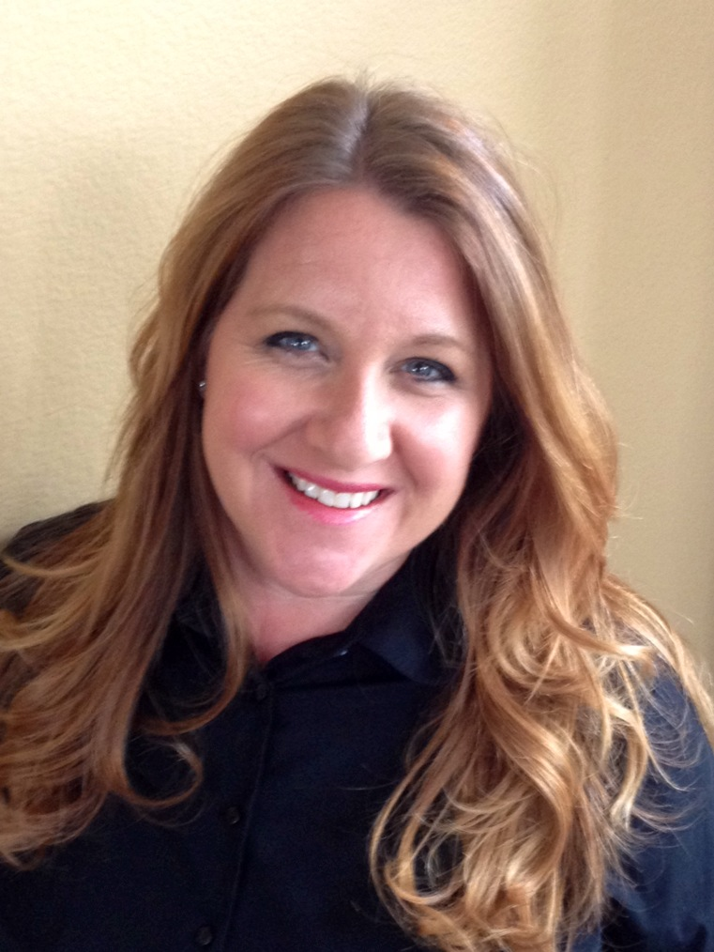
Montana Quality & Patient Safety Fellowship 2021
Session 3
Barbara DeBaun, MSN, RN, CIC
Improvement Advisor
Cynosure Health
Kim Werkmeister, MS, RN, CPHQ, CPPS
Improvement Advisor
Cynosure Health

Slide 2
Goals for the Program
Develop a foundational understanding of core concepts related to health care quality and patient safety
Hone necessary skills required to lead health care quality and patient safety projects
Apply skills to a SMALL quality improvement project from start to finish

Slide 3
Performance Improvement Project
Complete your project plan prior to April webinar
Set up coaching calls between April and May with Kim and Barb
Present project during July webinar

Slide 4
Introduction to Patient Safety

Slide 5
First do no harm
Patient safety is defined by the Institute of Medicine (IOM) as the prevention of harm to patients. Prevention of harm to patients includes a system of care delivery that:
Prevents errors
Learns from the errors that do occur
Is built on a culture of safety that involves health care professionals, organizations, and patients.

Slide 6
What we cannot do vs what we can do
Notes:
We can’t always cure a disease or fix an ailment; but at the very least, we must never do something that harms

Slide 7
Are infections and other healthcare associated harms EXPECTED in some patients?
Notes:
We used to talk about infections, complications, falls, etc as “the cost of doing business”. A critically ill patient on a ventilator that also developed a VAP was not something that any of us batted an eyelash at, as we really believed there was just no way to prevent it from happening in the midst of so many other factors for our complex patients. Today I would venture to guess that if your hospital doesn’t have a VAP rate of zero, it is very close.

Slide 8
How Safe are Hospitals?
Notes:
Surely being hospitalized is safer for patients than these high risk activities?

Slide 9
Notes:
In fact, being a patient in a hospital has been estimated to be more hazardous to your health than bungee jumping, working in a nuclear power plant, flying or driving. Numerous studies have found that 10%–12% of hospitalized patients experience adverse events while under the care of healthcare providers and organizations, with approximately half of these events considered preventable.

Slide 10
How
BIG
is
the
Problem?
Notes:
A transformative realization on the part of healthcare providers by the 1990’s was that despite training of providers, technology and the commitment to healing, hospitals were not safe for patients. In fact, they were inherently dangerous for many patients. Many adverse events and medical errors result in lasting damage requiring extended treatment times or permanent injury, or even unanticipated death.
There is consensus about the frequency of preventable harm in hospitals, but the number of deaths from them is a controversial issue.
Numerous studies have produced mortality estimates related to adverse events in hospitals with wide variance.
Measurement of adverse events remains a complex and evolving area, and there is not yet consensus for measuring overall safety at an organizational level.
Even when an adverse event is detected, it is sometimes difficult to determine whether the event was preventable because of the complexity of medical care.

Slide 11
To Err is Human: A Transformative Change in 1999
Foundational reading for anyone working to improve patient safety:
https://www.nap.edu/read/9728/chapter/1
Notes:
To Err is Human: Building a Safer Health System focused on a transformative thought; that healthcare is inherently risky and often results in unintended harm or death on a scale not realized widely prior to the report. The study found that approximately 44,000 to 98,000 patients each year die because of medical errors, and that many if not most of them preventable. The scope of medical errors reported by the Institute of Medicine (IOM) in To Err is Human include:
medication events such as the wrong drug or dose given to a patient,
hospital-acquired infections,
incorrect diagnosis,
or death due to unrecognized underlying medical conditions.
The exact number of deaths that can be attributable to medical error has been the subject of debate in subsequent studies that estimated even higher numbers of healthcare associated harm and unintended mortality. The report garnered the attention of the medical community, the public and the media immediately, and established patient safety as a priority on the national agenda.

Slide 12
Findings: To Err is Human
Medical errors occur because of flawed systems, not individual performance.
An increase in patient safety requires systems that are designed for safety and reliability.
A precursor to system redesign is a change in the culture of safety within healthcare at all levels.

Slide 13
Is it the best person or the best process?

Slide 14
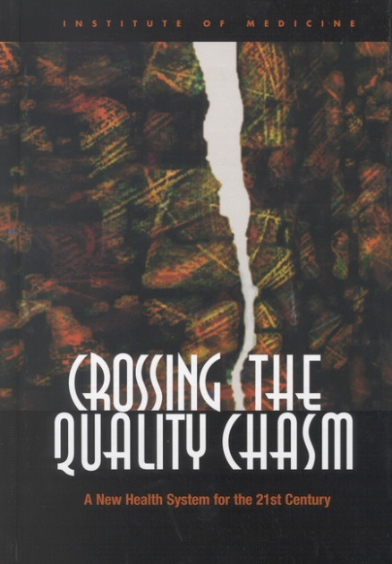
Crossing the Quality Chasm: The Follow Up
A roadmap for accomplishing changes recommended in To Err is Human
Notes:
In 2001 the IOM produced a second report as a follow up to the 1999 report called Crossing the Quality Chasm: A New Health System for the 21st Century. Crossing the Quality Chasm:
Mandated the fundamental change in the organization and delivery of health care
Provided a roadmap to accomplish those changes
Addressed how the healthcare system can be reinvented to foster innovation and improve the delivery of care.
A comprehensive strategy and action plan for the coming decade.

Slide 15
Crossing the Quality Chasm
In order to improve, health care must be provided in a manner that is:
Safe
Timely
Effective
Efficient
Equitable
Patient-centered
Notes:
The report focused on six specific aims for improvement. These aims were built around the core need for health care to be:
Safe: avoiding injuries to patients from the very care that is intended to help them.
Timely: reducing wait times and sometimes harmful delays, for both those who receive and those who provide care.
Effective: providing health care services based on scientific research and evidence to all who could benefit and refraining from providing services to those not likely to benefit.
Efficient: avoiding waste; including waste of equipment, supplies, ideas and energy.
Equitable: providing care that does not vary in quality, discriminate or promote disparities.
Patient-centered: providing care that is respectful of and responsive to individual patient preferences, needs and values; and ensuring that patients’ values guide all clinical decisions.

Slide 16
Who is to blame when a medical error occurs?

Slide 17
Avoid the ‘name blame and shame game’

Slide 18
From Error to Harm

Slide 19
The Swiss Cheese Model
Notes:
The Swiss cheese model, from James Reason, is a useful way to think about errors in complex organizations.

Slide 20
Your Organization’s Safety System In Theory
Slices of cheese prevent hazards from resulting in harm, but every now and then, the “holes” line up and cause harm.
The holes represent both latent conditions (so-called accidents waiting to happen) and active failures (errors and violations by front-line providers).
Notes:
The Swiss cheese model reveals the importance of improving latent conditions so that they do not eventually cause harm.
Voluntary reporting systems, in which providers submit reports on unsafe conditions and errors, can help improve unsafe conditions before they cause serious adverse events.
The Tenerife plane crash in 1977 is an example of how multiple unsafe conditions allowed the pilot to make an error, which the system then failed to stop from causing harm.

Slide 21
I’ve got your back
Notes:
Wing woman/wing man

Slide 22
Latent Conditions and Active Failures
Active failures: we see them happen – the point at which the wrong drug or treatment gets to a patient, the point at which the wrong switch is turned off
Latent failures are made by people whose tasks are removed in time and space from operational activities, e.g., designers, decision makers and managers.
Examples of latent failures are:
• Poor design of plant and equipment;
• Ineffective training;
• Inadequate supervision;
• Ineffective communications;
• Inadequate resources (e.g., people and equipment); and
• Uncertainties in roles and responsibilities.
Notes:
Teenage driver example

Slide 23
How do we turn handwashing into an example of failure?

Slide 24
Key Concept
Errors are the result of multiple failures in a process
Known errors are only a small fraction of potential harm
Notes:
We can’t just focus on known/reported errors – we must find a way to learn about near misses and other potential harm

Slide 25
How do we learn from a ‘near miss’?

Slide 26
A Closer Look at Error
Unsafe acts are categorized as either errors or violations.
An error is a lapse, slip, or a mistake.
When an action fails to go as intended, the error is called either a slip (if it is observable – like pushing the wrong button on a piece of equipment) or a lapse (if it is unobservable – like forgetting to give a medication).
When an action goes as intended but is the wrong one, it is called a mistake (such as a diagnostic error).
A violation is a deliberate deviation from an operating procedure, standard, or rules.
Notes:
An example of a slip is accidentally pushing the wrong button on a piece of equipment: You and others can see that you pushed the wrong button.
An example of a lapse is some form of memory failure, such as failing to administer a medication: No one can see your memory fail, so the error is not observable.

Slide 28
Key Concept
Human behavior plays a key role in errors
It is more important to find ways to address human behavior than it is to memorize the types of human errors

Slide 29
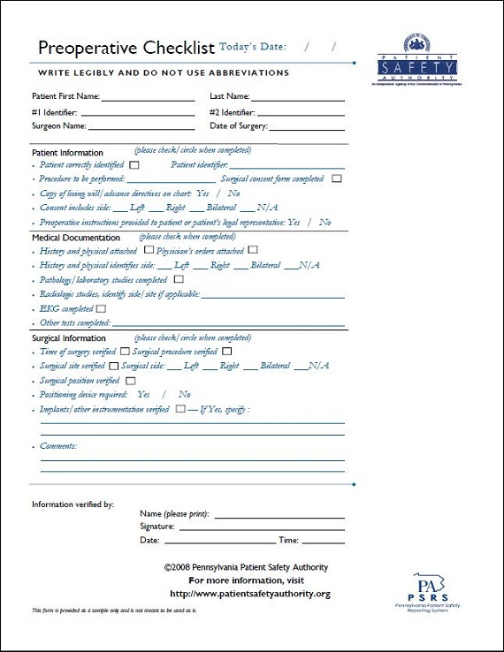
Tools to Reduce the Potential for Accidental Harm
Notes:
IHI has defined harm as “unintended physical injury resulting from or contributed to by medical care that requires additional monitoring, treatment, or hospitalization or that results in death.”
Patient safety innovators and patients have suggested a broader definition of harm, including three types of injury that have not traditionally been included in the definition of harm:
Errors of omission (what providers fail to do)
Psychological harm
Financial harm in the form of unaffordable care
A project in Michigan, US, developed a comprehensive safety system for reducing catheter-associated bloodstream infections (CLABSIs).
It included a checklist, supply carts, and explicit roles for the various members of a care team.
The system showed that hospitals could nearly eliminate CLABSIs, which people once thought to be an inevitable complication of care.
The history of medicine shows that many harms that used to be accepted are actually preventable, including high doses of chemotherapy, radical mastectomies, and overuse of antibiotics that leads to resistance.

Slide 30
Key Concept
Humans make mistakes, and relying on memory is a great way to ensure mistakes will be make
Checklists have been found to reduce errors significantly

Slide 31
It’s like going to the grocery store without a list

Slide 32
Time to share

Slide 33
Discussion
What methods and safety mechanisms are in place in your organization?
What mechanisms that are supposed to increase safety, actually create more work or unsafe conditions in your organization?

Slide 34
Thank you!
Contact Information for Coaching
Barb DeBaun
bdebaun@cynosurehealth.org
Kim Werkmeister:
kwerkmeister@cynosurehealth.org

