Slide 1
The revenue cycle
Ralph Llewellyn – rllewellyn@eidebailly.com

Slide 2
Why the Revenue Cycle

Slide 3
It impacts everything!
Accounts Receivable Days
Gross Revenue
Net Revenue
Operating Margin
Net Margin
Days Cash on Hand
Debt Service Coverage

Slide 4
Potential impact
Every dollar found hits the bottom line
Low hanging fruit is typical available

Slide 5
Key performance indicators

Slide 6
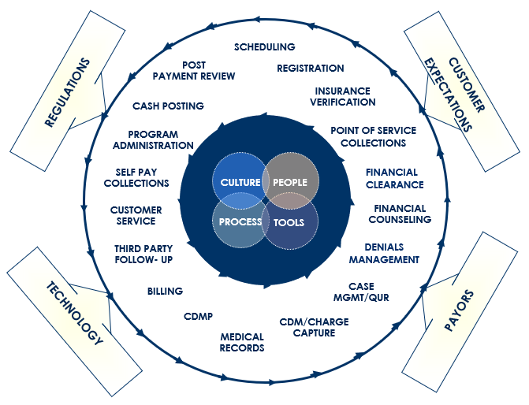
THE REVENUE CYCLE
A successful revenue cycle is a complex process which involves multiple areas of your organization requiring constant interaction.

Slide 7
reporting
Tools available
Communication process
Frequency
Customize to your organizational structure
Identify current KPIs and set targets

Slide 8

Where to start?
Assure policies and procedures are in place to outline expectations.
Shadow individuals to observe tasks.
Instruct staff to document processes:
  Have other staff follow the steps to fill in gaps.
Perform chart-to-payment reviews.
Provide feedback for staff education and training.
How often are P&P reviewed and updated?

Slide 9

EXPECTED RESULTS IN THE ABSENCE OF P&P
No standardization of processes
Variation in charge capture
Non-compliance with billing rules and regulations
Inability to hold staff accountable
Billing delays when staff member is out of the office

Slide 10
Revenue Cycle Benchmarks
Days in A/R: | < 45 Days
Aged Insurance Pending A/R as a % of Total Ins Pending A/R | Report by discharge date < 20% over 90 days < 5% over 180 days (By financial class and further into any carriers with timely filing limits < 180 days. Remove credit balances)
Discharged Not Final Billed-DNFB | < 5 days of average daily revenue
Credit Balances | < 1 day of daily revenue
Denial Write-Offs | < 1% of monthly net revenue
Point of Service Collections | > 3% of monthly net revenue
Registration Error Rate | < 5% of daily registered patients
Mail Return | < 5% of mailed items
Claim Hold Days | 2-3 business days

Slide 11
Summary aging sorted by:
Financial Class
Aged by buckets (unbilled, 0-30, >30, >60, etc.)
Date of service when working timely filing
Last billed date when working aged accounts with activity
Without credit balances
Detail aging to focus on:
Timely filing limits – accounts at risk
Credit balances (state unclaimed property)
Aged accounts with payment still in primary financial class
Established high dollar amounts
Unapplied payments
A/R ANALYSIS

Slide 12
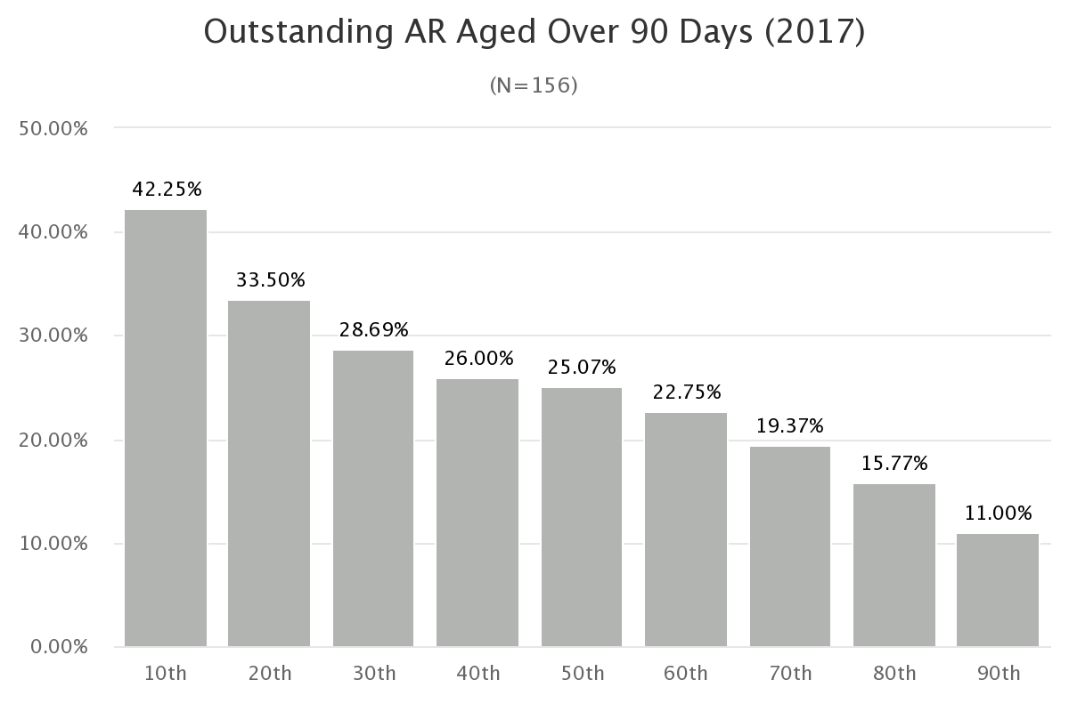
National averages
Hospital

Slide 13

Adjustments
Contractual → Post only as reported on remittance advice.
Denied charges that can be appealed.
Administrative adjustments based on organizational policies and procedures:
  Small balance write-off
  Untimely filing
  Provider not enrolled
  Medical necessity
  Late Charge
  Medicare Bad Debt (ability to run report)
Segregation of duties:
  Biller completes log for review by coworker
  Manager approves
  Posted by data entry clerk or payment posting staff

Slide 14
PATIENT
ACCESS

Slide 15
First impressions
Can “make or break” the patient experience
Frontline of the organization’s customer service
Keep registrars informed of changes
  New service being provided
  Provider joining organization
  Media release
When faced with a new challenge, who can assist with resolution?
Grievance process
Phone etiquette → Patient focus vs. answering incoming calls
Knowledge of billing system → current balance/payment verification

Slide 16

Data collection
50% of claim data originates with the Registration Staff
Patient demographic information
Encounter specific information
Insurance coverage
  Primary vs. secondary or tertiary
  Insured
  Relationship to insured
  Group number
  Remaining 50% is comprised of Coding, Charge Entry and Billing required data.

Slide 17
Patient Access Responsibilities
Identify patient
Choose patient type based on services to be provided
Verify insurance eligibility
  PCP referrals
Determine pre-authorization status
Complete required registration document
Obtain/explain signature requirements
  HIPAA notice
  Conditions of Admission/Consent for treatment
  Patient Rights and Responsibilities
  Medicare Secondary Payer Questionnaire
Collect copay or minimum balance
  Substantial increase in patient deductibles
Scheduling
Patient Portal education

Slide 18
Patient access tools
Verification of coverage
  Phone call
  Online payer portals
  Vendor (billing system or clearinghouse)
Price estimates
Online credit card and receipt processing
Insurance card scanner
Payment options
Scripting (essential for upfront collection success)

Slide 19
Do these duties belong in Patient Access?
How do we expect registration staff to perform these duties?
ABN – LCD/NCD should be built into order entry
Pre-authorization – Before services are performed
  May not be aware until patient has presented
Often lack
Privacy to discuss diagnosis with patient
Medical terminology skill set to answer questions
Access to provider when issues arise
Consideration for “need to know”.

Slide 20
Coding and charge capture

Slide 21
Chargemaster Maintenance
Yearly Review
Regulatory updates
HCPCS and ICD-10 changes – Bundling/Unbundling
Revenue Reliability
Updates to billing system – Crosswalk to G/L
Payer Changes
Pricing
Contract constraints
Compare to highest paying fee schedule
Medicare pays lesser of MPFS or charge
Compliance
Overarching governance and oversight of the Revenue Cycle functions

Slide 22

Charge capture
Missed charges results in missed revenue opportunity:
  Revenue and usage report review
Charge capture process:
  Documentation generated charges vs. manual entry
  Paper charge tickets
  System interface issues
Charge reconciliation → Assure all charges match patient record:
  Facility fee identified as site of services
  Drugs & supplies
  Infusion – Injection - Hydration
  Lab and Radiology
  Therapy services
  Contracted services
  Venipuncture

Slide 23
Common areas of confusion/lost revenues
How do CPT/HCPCS Codes get assigned
  HIM adds to revenue code line during coding
  Hard coded into the Chargemaster
Pharmacy
  Unit mismatch with HCPCS code
    Amount administered doesn’t crosswalk exactly to HCPCS code definition
  Missing JW modifier reporting for medication waste
Omission of outpatient nursing procedures
  IV therapy, injections, blood administration
  Unbillable due to missing nursing documentation
    Start and stop times
    Administration sites
    Drugs administered
Flu/Pneumo vaccinations administered during inpatient stay
  Separately billable on the 012X type of bill to Medicare Part B
    Use discharge date regardless of date administered

Slide 24
billing and follow-up

Slide 25
Payer CONTRACTS
Payers are tightening their reimbursement by passing on changes to the providers:
    Tougher negotiations
    Complex contract terms
    Increasing denial rates
    Underpaying providers based on contracts
Contribute to major drains on margins:
    Average facility loses 5% of annual revenue
    Preventable revenue loss
Are staff aware of what’s in your contracts?

Slide 26

UNDERPAYMENTS
Monitor reimbursement amounts to assure they align with payer contracts.
Contact payer when underpayment is identified:
  Ability to have claim reprocessed vs. appealed
Claim corrections and resubmission:
  Online options
Identify denied line items and action required:
  Noncovered vs. denied

Slide 27

System issues affecting a/R
Bill hold days
Documentation not signed off on in EHR
  Monitoring reports
Incomplete/inaccurate key patient data from registration
  Have registrar correct for education
Late Charges
Nonexistence of account notes in billing system for follow-up

Slide 28

Tools
Payer specific portal to check claim status and make adjustments:
Medicare Direct Data Entry (DDE)
Payer portal sign-on with passwords
Work queues:
Payer specific vs. alpha-split
Denials
Aged accounts
Registration errors
Coding edits

Slide 29

Claim transmission verification
Internal billing software edits.
Clearinghouse edits.
Transmission reports - Compare to system generated claim counts:
  837 – Claims transmitted
  999 – Acknowledges receipt of claim file
  277 – Acceptance file (rejected claims)
Work rejected claims within 24 hours:
  Skews billing reports when system shows claim was dropped but insurance company didn’t accept.
  No remittance advice denial will be received.

Slide 30

DENIAL MANAGEMENT
90% of all denials are preventable.
About 2/3 of these are recoverable.
Payers may not allow an adjusted claim (be aware of contracts).
Resolution and effort involved to overturn denials.
Financial impact of denials on the organization’s bottom line.

Slide 31
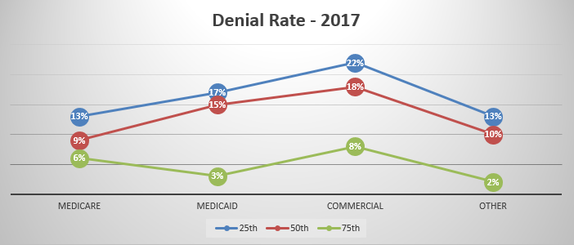
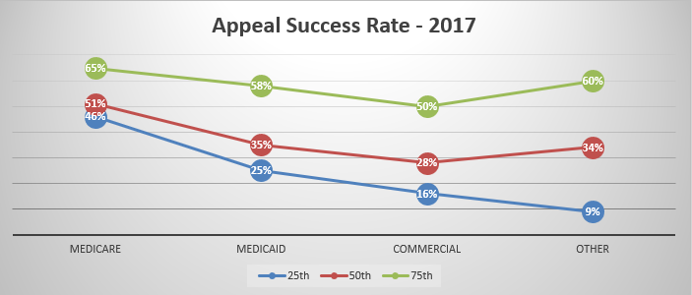

Slide 32
Steps to follow
Conduct initial assessment to identify gaps in outstanding accounts.
Consistent report monitoring:
Daily, weekly, monthly, quarterly, yearly
Compare findings from week-to-week or month-to-month, etc.
Develop Action Plan as issues arise.
Run reports in limited quantity to finish review of all accounts:
Focus on assigning accounts by alpha
Date of service ranges

Slide 33
CRNA Billing
CAH Method I
Professional services are billed on CMS-1500 to Medicare Part B
  Paid at 100% of the allowed amount (80% Medicare + 20% coinsurance)
Technical services billed under RC 037X on the CAH UB-04 TOB 085X
  Paid at 101% of reasonable cost
CAH Method II
Professional Charges
  Outpatient are billed on the UB-04 under revenue code 0964 with CAH NPI
    TOB 085X only
    QZ modifier is appended to HCPCS code
    Paid at 115% of the allowed amount
  Inpatient billed on CMS-1500 to Medicare Part B
    Paid at 100% of allowed amount
Technical services billed under RC 037X on the CAH UB-04 TOB 085X
  Paid at 101% of reasonable cost for anesthesia and supplies

Slide 34
Crna billing cont
CAH electing/qualifying for Pass-Through Exemption
All professional services are billed on the CAH UB-04 under RC 0964 to Medicare Part A
  TOB 085X, 011X and 018X (Outpatient, inpatient and swing-bed claims)
  Reimbursed at 100% of reasonable cost
Technical services are billed under RC 037X on the CAH UB-04
  TOB 085X paid at 101% of reasonable cost
  TOB 011X and 018X payment included in the daily per diem rate (reasonable cost)
NOTE:
Medicare and most other payers require billing minutes not units when billing CRNA professional services

Slide 35
Fee-for-time compensation arrangements
Formerly referred to as “Locum Tenens Arrangements”.
Substitute physician who practices in place of another physician who is temporarily absent for no more than 60 continuous days.
  Vacation
  Medical leave
  Continuing education
  Sabbatical
  Physician leaves a Group practice
Medicare definition of physician
Modifier Q6

Slide 36
What Fee-for-time compensation is not
A non-physician provider
  NP, PA, CNM, do not meet the definition
    A substitute provider cannot be a non-physician provider nor can be billed as one
Billing option while waiting for enrollment
Used to grow a practice
Caution when using outsourced agency to fill ER schedule

Slide 37
Collections

Slide 38
Point-of-service collections
Cost to collect upfront less than when done on the back-side
  Net patient revenue collected at POS
    Nationally best practice collections are 2.68%
    Midwest average is .04% to 1.23% for high performing organizations
Prompt Pay Discounts
  Average organization offers 20%
    Range is from 10% to 50% Nationally
    Midwest average prompt pay discount is 15% - 20%
Cost to Collect
  Full cost to collect divided by net patient revenue
    Nationally → Total 3%
      Point-of-service 0.07%
      Business Office 1.20%
    Midwest → Total 4%
      Point-of-service 0.93%
      Business Office 1.81%

Slide 39
Credit balances
Posting
errors
Corrected/ adjusted claims
Posted to
incorrect
encounter
Primary payer disputes
Coordination of benefits
Duplicate payment
Liability claim
Overpayment
Patient payments
Transfer
balance
Up-front collections

Slide 40
Patient financial journey
Lay the foundation on the front end:
  Patient expectations
  Options available
  Share deductible/coinsurance information
Educate staff so as to communicate same message throughout each step of patient encounter.
Follow-up with patient balance due in a timely manner.
Establish policies and procedures and follow them for self-pay balances.
Look for opportunity to automate processes and reporting capabilities.
Publish contact information on all correspondence and website.

Slide 41
statements
Frequency of statements
Manual vs. automated process
Weekly vs. monthly
Prompt pay discounts – post adjustment at time of payment
At time of service
Within “XX” days from first statement
Negotiating tool for large balances remaining due
Underinsured vs. Uninsured
Minimum balance
Guarantor
Patient
Contract requirements (Medicaid copay amounts)

Slide 42
Strategic planning

Slide 43
Revenue cycle strategic plan
Optimize revenue growth without relying entirely on new volumes.
Reduce revenue erosion
  Shift the organizational thought process to performance which centers on collection of the services provided.
  Software & clearinghouse edits don’t make up for
    Missed charges
    Undocumented services (start/stop times for infusion or observation)
    Documentation that doesn’t support medical necessary
New Services
  Notification of coding and billing staff
  Medical necessity rules
  Documentation requirements
Focus on assisting with obstacles the revenue cycle is facing vs. blame.

Slide 44

who are the players?
Shift Ownership to the stakeholders.
  Ancillary departments
  Providers
  Management
Look to three key areas for overall organizational success.
  Physicians
    Provide documentation training to explain the revenue impact of inaccurate documentation.
    Address and work together on their pain points with the revenue cycle process.
    Target ways for staff/tools to maximize their performance.
  Patients
    Faced with higher financial obligations for healthcare services than in the past.
    Educate them on their coverage/out of pocket obtained at time of insurance verification.
    Be prepared to offer options for meeting financial responsibility.
  Payers
    Insurance Matrix

Slide 45
Breakdown silos
Revenue Cycle cannot continue to operate in a silo.
  Whose job is it?
  Seek buy in from all departments within the organization.
  Send the same message to your patients and communities in every area of the organization.
  Dedicate IT staff.
Focus on letting the public and staff know that your organization WANTS to be the best.
Management
Providers
Ancillary Staff
Registration
Coding
Billing
Collections

Slide 46
Reduce write-offs
Providers
  Pre-authorizations
  Provider not enrolled
  Referrals
  Documentation deficiencies
  Medical necessity denials - ABN
Coding
  Incidental service denials due to lack of modifiers
  Assure proper coding of combined accounts for same DOS
Claims processing
  Timely filing limits
  Appeal processes
  Account follow-up

Slide 47
Supporting Revenue Cycle at the highest level
Top leadership that understands and appreciates critical role of financial performance in supporting care delivery.
Garnering appreciation from non-finance staff
Perform Revenue Cycle 101 training to non-revenue cycle departments.
Demanding high performance
Leadership demonstrates passion to do better and drives excitement around improvement initiatives.
Celebrating success
Foster an attitude of gratitude.
Make innovations a priority
Focus on staff willingness/adapters of new processes and technologies.
Willingness to devote time and resources to issues affecting financial services.
Help participants understand positive impact within their own departments.

Slide 48

Organizational Culture
Are you prepared to lead the Organizational Culture change as it relates to the Revenue Cycle?

Slide 49
questions?

Slide 50
QUESTIONS?

Slide 51
THANK YOU
Ralph Llewellyn
Partner
rllewellyn@eidebailly.com
701.239.8594

